Slide 1
GCSE Art & Design

Slide 2
Art or Graphics?

Slide 3
Transferable skills for all career areas
Creative thinking and problem solving
Critical thinking, evaluation and analysis
Time management and working to a deadline
Project planning and execution
Self-motivation, independent working habits
Courage and risk-taking

Slide 4
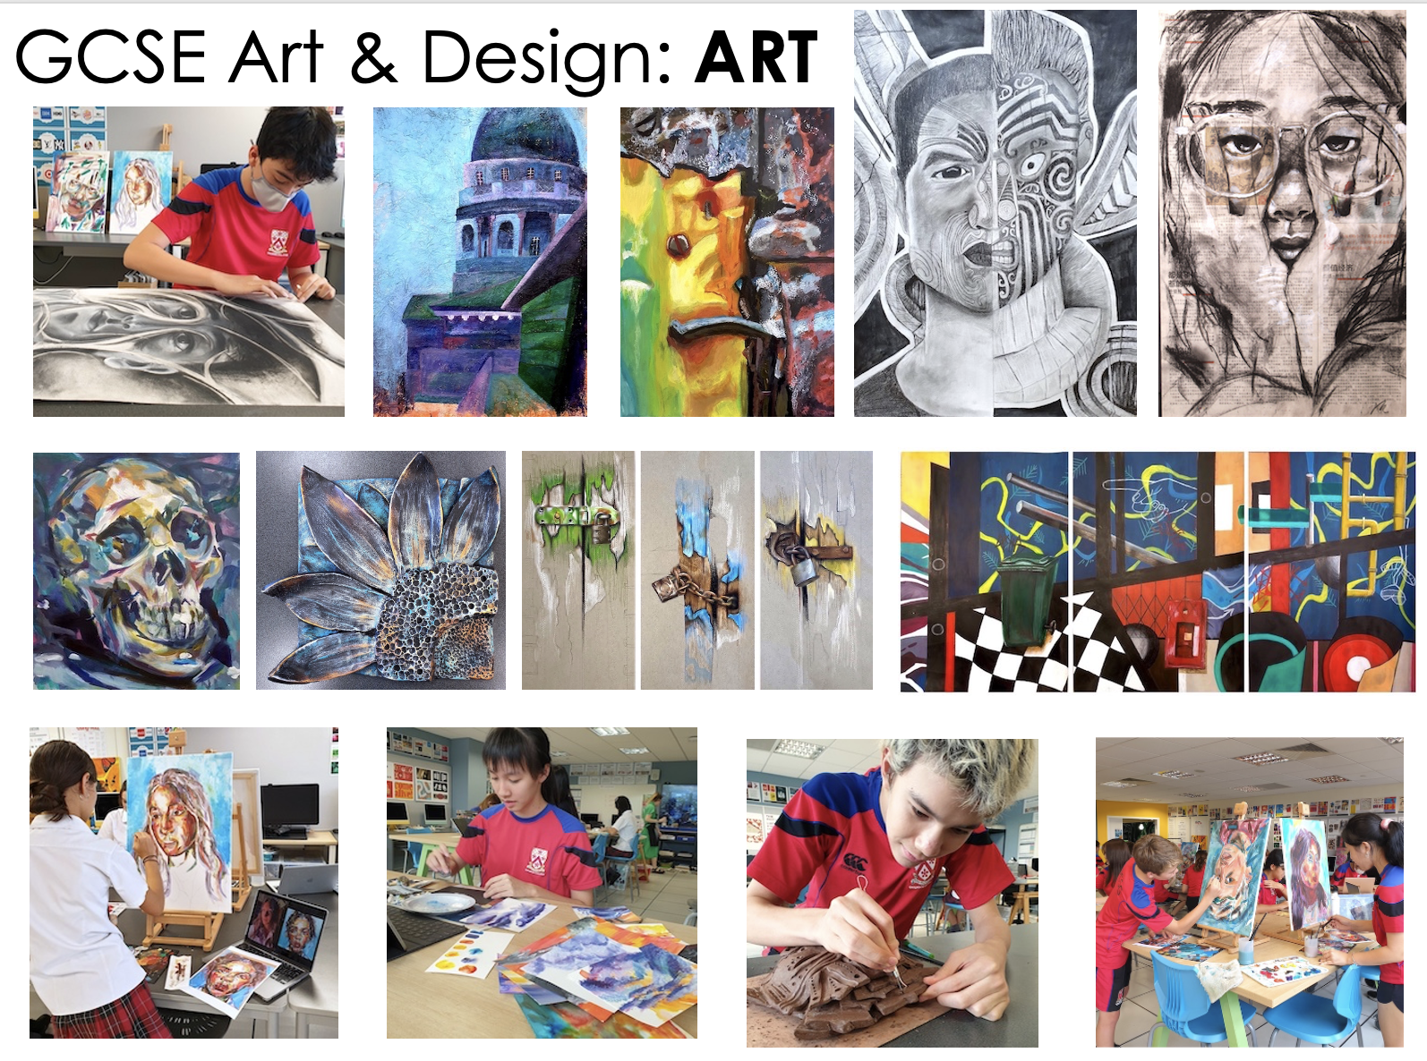
You will create artworks which explore and communicate your own ideas, preferences and thoughts to the viewer.
Open-ended creativity, freedom of expression, risk-taking and refinement are especially important skills developed in Art.
Areas of Study:
Drawing
Printmaking
Painting
Photography
Sculpture
Digital media
Mixed media

Slide 5
You will create designs, products and images which convey information, ideas or concepts to the viewer. These will balance artistic and commercial considerations.
Visual awareness, design thinking, creative problem solving and an eye for detail are especially important skills developed in Graphics.
Areas of Study:
Advertising
Typography
Illustration
Communication Graphics
Design for print
Multi-media
Packaging Design

Slide 6
Why choose ART?
You enjoy art lessons, especially the choice and freedom they give you to explore and express yourself independently.
You want a well balanced school curriculum for the next three years which involves creativity, personal involvement and self-expression.
You enjoy using and experimenting with different art materials and would like to learn even more.
You enjoy hands-on learning, away from a screen.
You might be interested in a career in the creative industries (illustration, architecture, advertising, animation, web design, typography, interior design) and would like to develop your artistic skills.

Slide 7
Why choose GRAPHICS?
You enjoy art lessons, but prefer to have a clear outcome or ‘design brief’ to work towards.
You want a well balanced school curriculum for the next three years which involves creative problem solving, choice and self-expression.
You admire the designs you see around you – lettering, posters, clothing, logos, websites or products – and would like to create your own.
You enjoy using technology to create content and would like to explore what digital design software can do.
You might be interested in a career in the creative industries (illustration, architecture, advertising, animation, web design, typography, interior design) and would like to develop your design skills.

Slide 8
Why choose BOTH?
We have several students who have opted for both art and graphics at GCSE. If you are thinking of this, ask yourself these questions:
Are you really enthusiastic about art and design and would love to pursue a career in the arts or creative industries?
Are you self-motivated and do you enjoy practical homework?
Do you plan on taking art at IB level?
PLEASE NOTE: We encourage students to aim for breadth with their options. Students can opt for both GCSE Fine Art and GCSE Graphic Communication. Students would need to ensure they demonstrated breath with their other choices and students wanting to pick both pathways would need to discuss this in their 1-1 interview with a member of the leadership/pastoral leadership team.

Slide 9
Course Assessment
Both Art and Graphics have the same course structure and weighting of marks.
60% Personal Portfolio (coursework)
40% Externally Set Assignment (final project – timed test)
There are four assessment objectives, each worth 25%. These should be very familiar to you from the Art Skills we cover in Year 7 and 8.
AO1: Develop ideas through research, demonstrating an understanding of sources
AO2: Refine work by exploring ideas, experimenting with materials and techniques
AO3: Record ideas, observations and insights relevant to your intentions
AO4: Present a personal, meaningful response that realises your intentions
NB: There is no written exam in art and nothing to revise for.
The Externally Set Assignment takes place before all your other exams.
All your work will be internally marked and externally moderated.

