Slide 1
Dingbats Book Title Quiz Can you work out the book titles represented by the dingbats?

Slide 2
1.

Slide 3
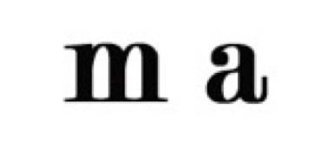
2.

Slide 4
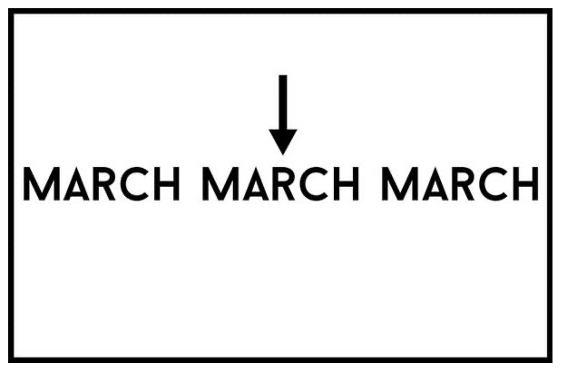
3.

Slide 5
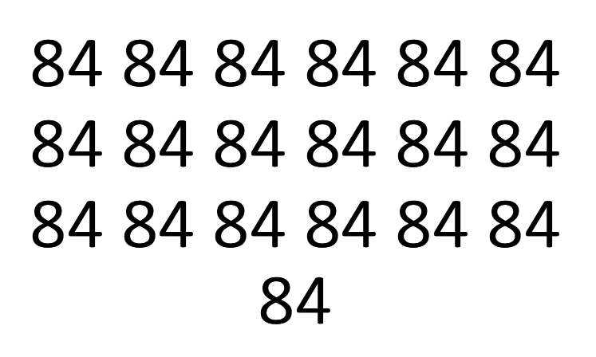
4.

Slide 6
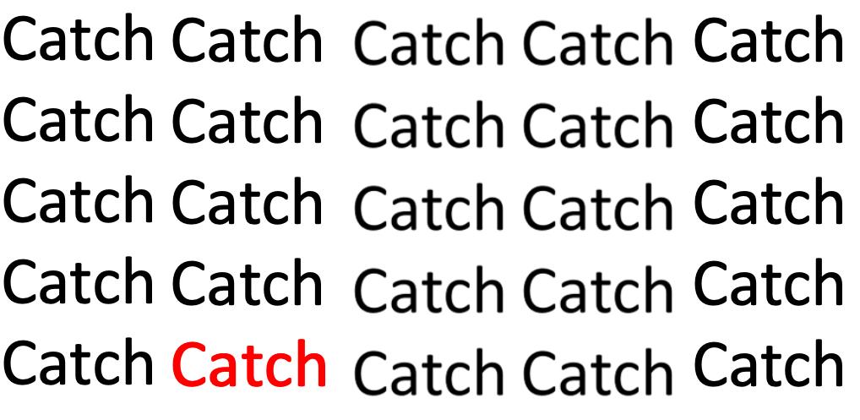
5.

Slide 7
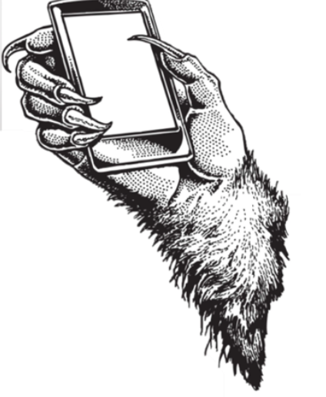
6.

Slide 8
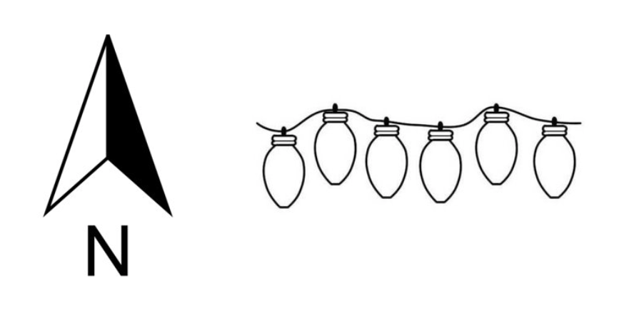
7.

Slide 9
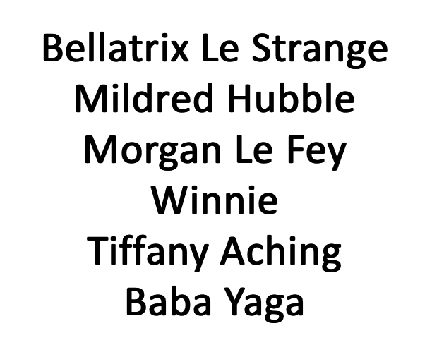
8.

Slide 10
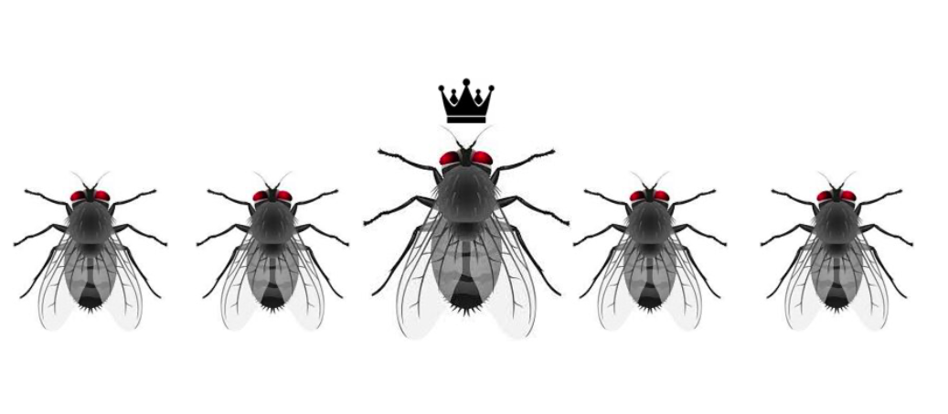
9.

Slide 11
10.
d

Slide 12
11.

Slide 13
12.

Slide 14
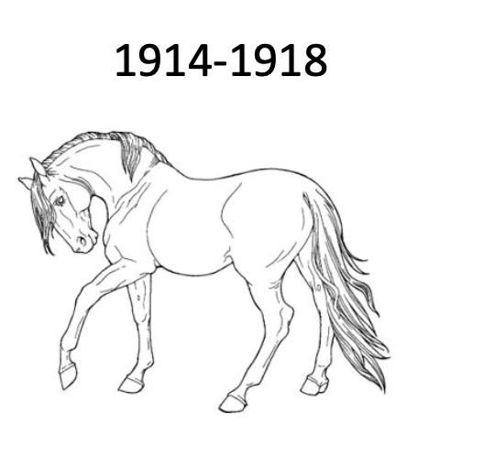
13.

Slide 15
14.

Slide 16
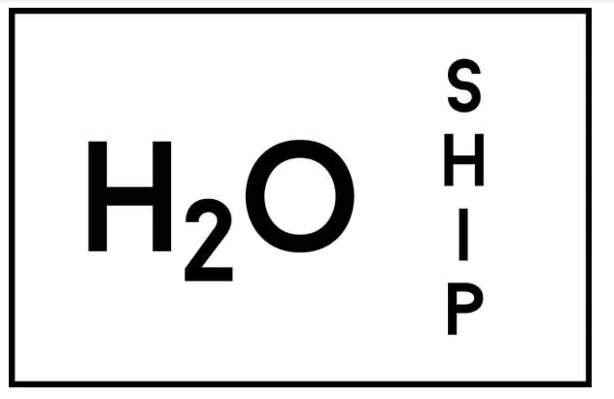
15.

Slide 17
Answers on the next page

Slide 18
The Great Gatsby by F. Scott Fitzgerald
Emma by Jane Austin
Middlemarch by Georg Eliot
1984 by George Orwell
Catch 22 by Joseph Heller
A Monster Calls by Patrick Ness
Northern Lights by Philip Pullman
The Witches by Roald Dahl
The Lord of the flies by William Golding
Heidi by Johanna Spyri
The Colour Purple by Alice Walker
The fault in our stars by John Green
War Horse by Michael Morpurgo
Black Beauty by Anna Sewell
Watership Down by Richard Adams

