Slide 1
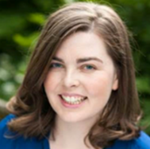
Year 9 Author Workshop
With Alwyn Hamilton
Signed copies of her books can be ordered.
Please visit the library for order forms.
Thursday, 1 March 2018
Thank you to FoD for sponsoring this talk.

Slide 2
SS Author Talk
With Oliver Phommavahn
Signed copies of his books can be ordered.
Please visit the library for order forms.
Friday, 9 March 2018
Thank you to FoD for sponsoring this talk.

Slide 3
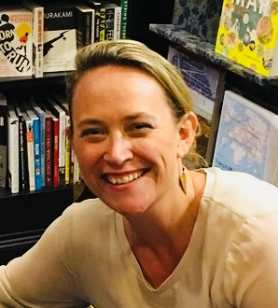
Year 10 Short Story Writing Workshop
With Alice Clark-Platts
Thursday, 8 March 2018

Slide 4
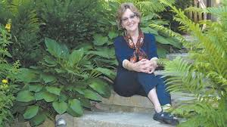
Year 7 Author Talk
With Noelle Jack
Monday, 5 March 2018

