Slide 2
Theory Of Knowledge
Introduction

Slide 3
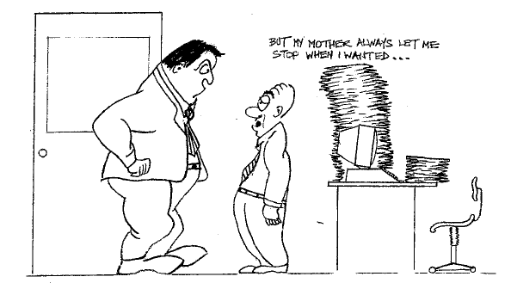
Notes:
Slide 4 - Image(s)/chart(s) only

Slide 4
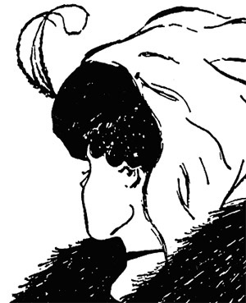
a little…
TOK
…goes along way.
sit amet pinquido

Slide 5
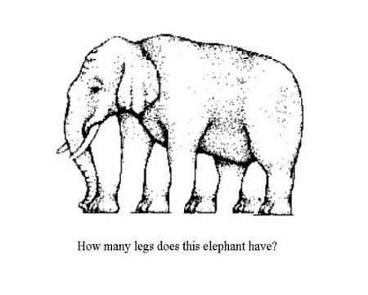
Notes:
Slide 2 – Text only

Slide 6
“To a man with a hammer, everything looks like a nail.”
Notes:
Slide 4 - Image(s)/chart(s) only

Slide 7
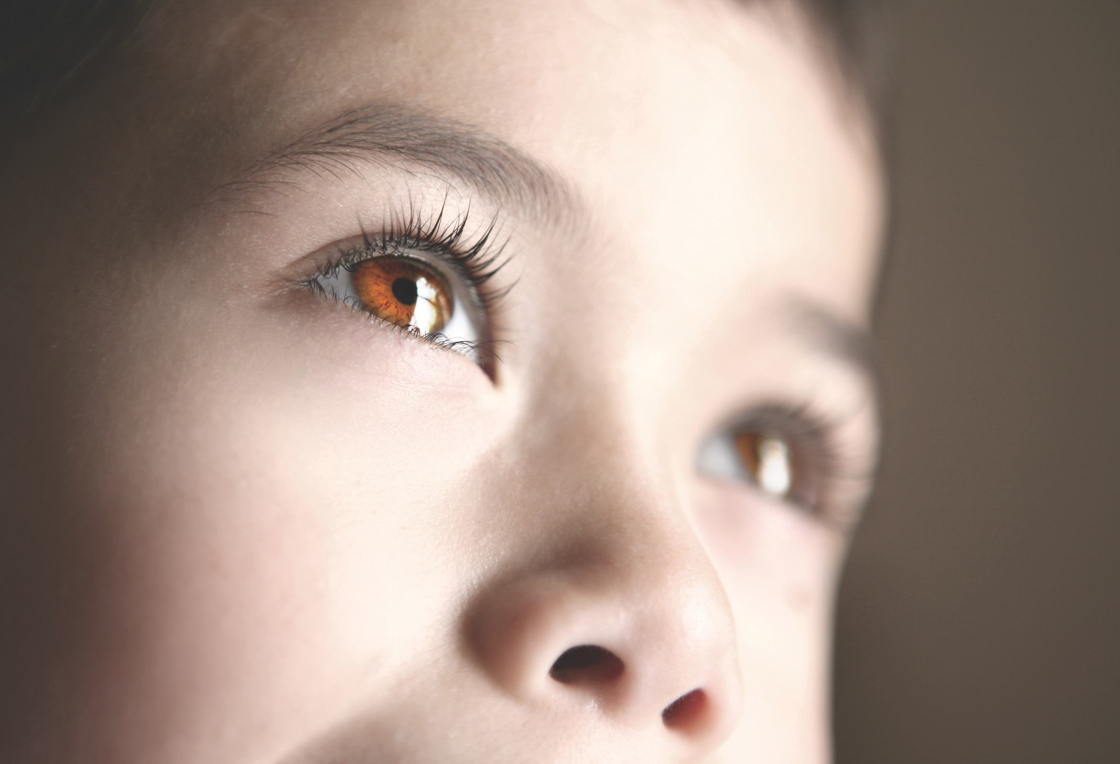
“Was Mathematics invented or discovered?”

Slide 8
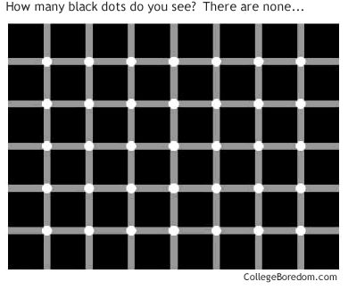
Notes:
Slide 2 – Text only

Slide 9
“One has no knowledge of the sun but only of an eye that sees the sun, and no knowledge of earth but only of a hand that feels an earth.”
Arthur Schopenhauer
Notes:
Slide 4 - Image(s)/chart(s) only

Slide 10
Notes:
Slide 4 - Image(s)/chart(s) only

Slide 11
“To know one’s ignorance is the best part of knowledge.”
Lao Tse, c. 565 BCE

Slide 12
Notes:
Slide 4 - Image(s)/chart(s) only

Slide 13
Notes:
Slide 4 - Image(s)/chart(s) only

Slide 14
“There are two ways to slide easily through life: to believe everything or to doubt everything; both ways save us from thinking.”
Alfred Korzybski, 1879-1950

Slide 15
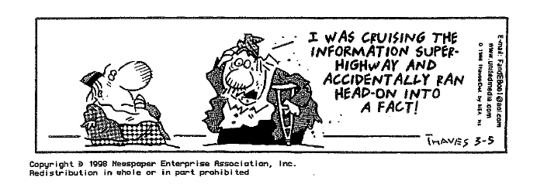
Notes:
Slide 4 - Image(s)/chart(s) only

Slide 16
Notes:
Slide 4 - Image(s)/chart(s) only

Slide 17
“I think therefore I haven’t a clue.”
Phillip Adams

Slide 18
Notes:
Slide 4 - Image(s)/chart(s) only

Slide 19
“What separates science from all other human activities is its belief in the provisional nature of all conclusions. In science, knowledge is fluid and certainty fleeting. That is the heart of its limitation. It is also its greatest strength.”
Michael Shermer
Notes:
Slide 4 - Image(s)/chart(s) only

Slide 20
Notes:
Slide 4 - Image(s)/chart(s) only

Slide 21
“Science is built with facts just as a house is built with bricks, but a collection of facts cannot be called a science any more than a pile of bricks can be called a house.”
Henri Poincaré
Notes:
Slide 4 - Image(s)/chart(s) only

Slide 22
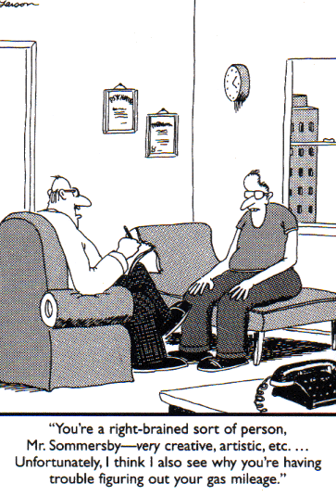
Notes:
Slide 4 - Image(s)/chart(s) only

Slide 23
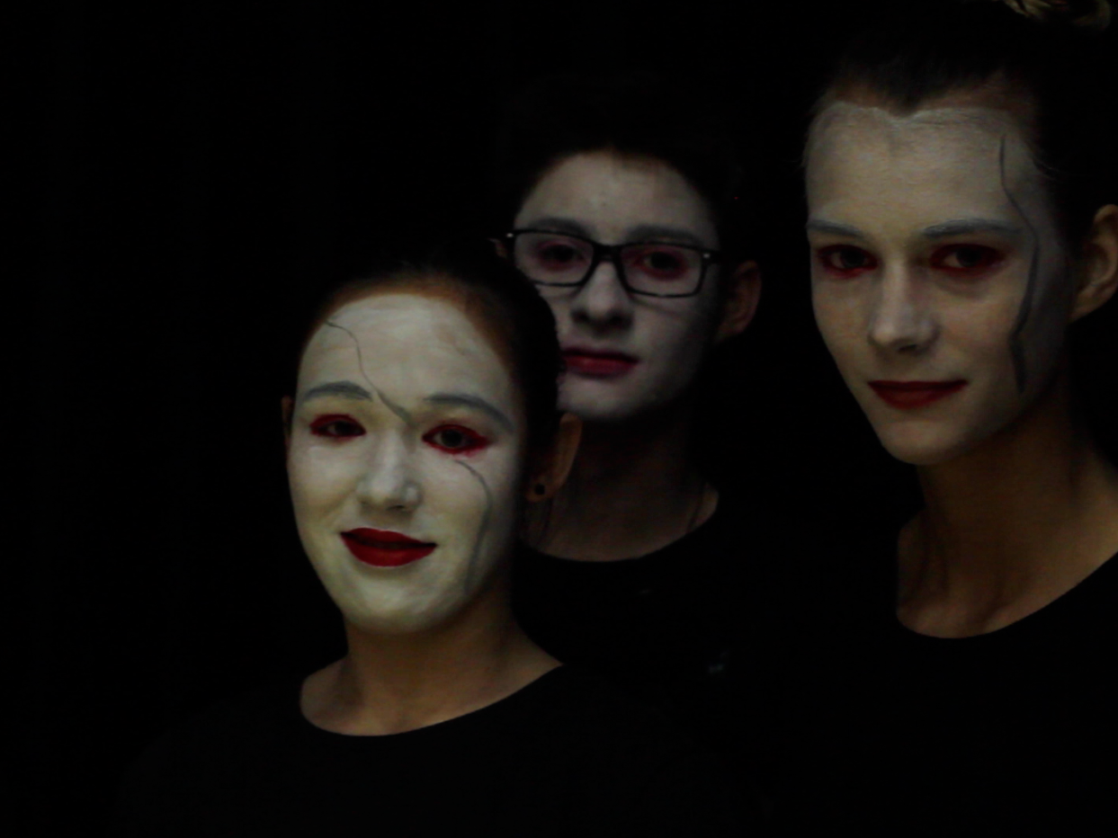
“Knowledge has killed the sun,
making it a ball of gas with spots.”
D.H. Lawrence

Slide 24
Notes:
Slide 4 - Image(s)/chart(s) only

Slide 25
Why did the chicken cross the road?
Aristototle – It is the nature of chickens to cross the road.
Karl Marx – It was a historical inevitability.
Captain James T Kirk – To boldly go where no chicken has gone before.
Freud – The fact that you are at all concerned that the chicken crossed the road reveals your underlying sexual insecurity.
Einstein – Did the chicken really cross the road or did the road move beneath the
Chicken?
George W Bush – I don’t think I should have to answer that question.
Notes:
Slide 4 - Image(s)/chart(s) only

Slide 26
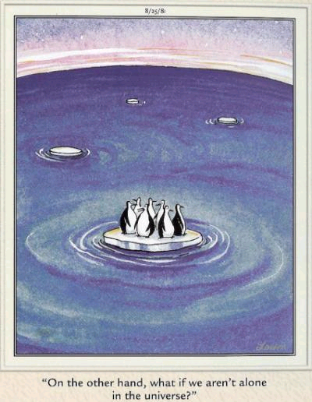
Notes:
Slide 4 - Image(s)/chart(s) only

Slide 27
‘Nothingness’ by Aharon Amir
I woke up at night and my language was gone
No sign of language no writing no alphabet
Nor symbol nor word in any tongue
And raw was my fear – like the terror perhaps
Of a man flung from a treetop far above the ground
A shipwrecked person on a tide-engulfed sandbank
A pilot whose parachute would not open
Or the fear of a stone in a bottomless pit
And the fright was unvoiced unlettered unuttered
And inarticulate O how inarticulate
And I was alone in the dark
A non-I in all the pervading gloom
With no grasp no leaning point
Everything stripped of everything
And the sound was speechless and voiceless
And I was naught and nothing
Without even a gibbet to hang onto
Without a single peg to hang onto
And I no longer knew who or what I was
And I was no more.
Notes:
Slide 4 - Image(s)/chart(s) only

Slide 28
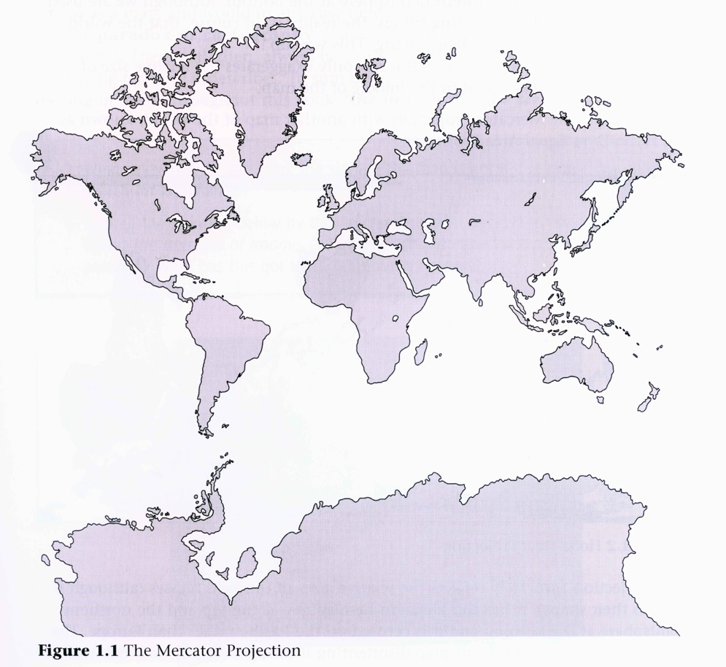
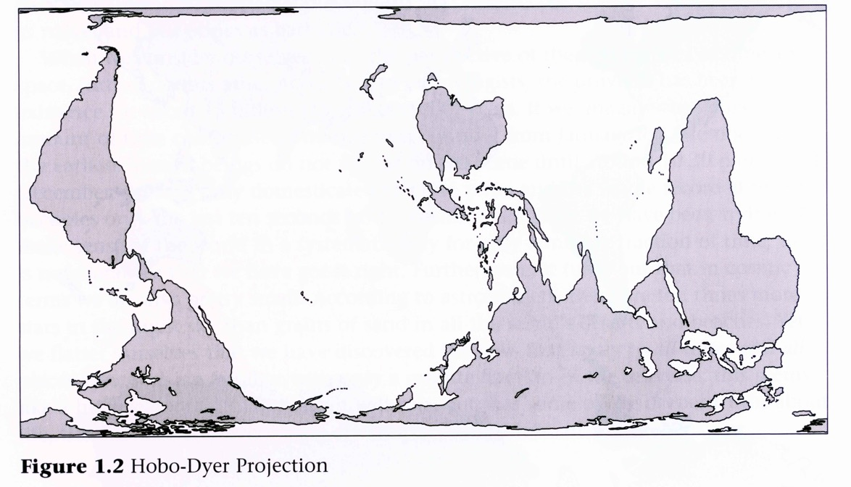
Notes:
Slide 4 - Image(s)/chart(s) only

Slide 29
A man of Seville is shaved by the Barber of Seville if and only if the man does not shave himself. Does the Barber of Seville shave himself ?
Bertrand Russel’s paradox of 1918

Slide 30
Notes:
Slide 4 - Image(s)/chart(s) only

Slide 31
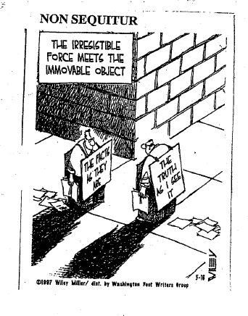
Notes:
Slide 4 - Image(s)/chart(s) only

