Slide 1
2. Finding Sources

Slide 2
Using Databases to Find Articles

Slide 3
Articles in Databases: Newspapers & Magazines
Written by journalists (non-specialists)
Reviewed by an editor, not a panel of experts
Sources may not be mentioned in the text
Written to inform and entertain
Funded by advertising and subscriptions
Good for: up-to-the-minute information, analysis of current events

Slide 4
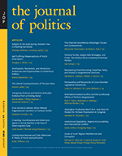
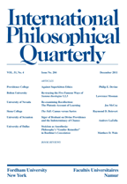
Articles in Databases: Academic Articles
Written by scholars (specialists in their field)
Often go through peer review
Specialised terminology
Generally have bibliographies and citations
Appear in specialised journals (often published by universities) with minimal advertising
Good for: In-depth, expert analysis

Slide 5
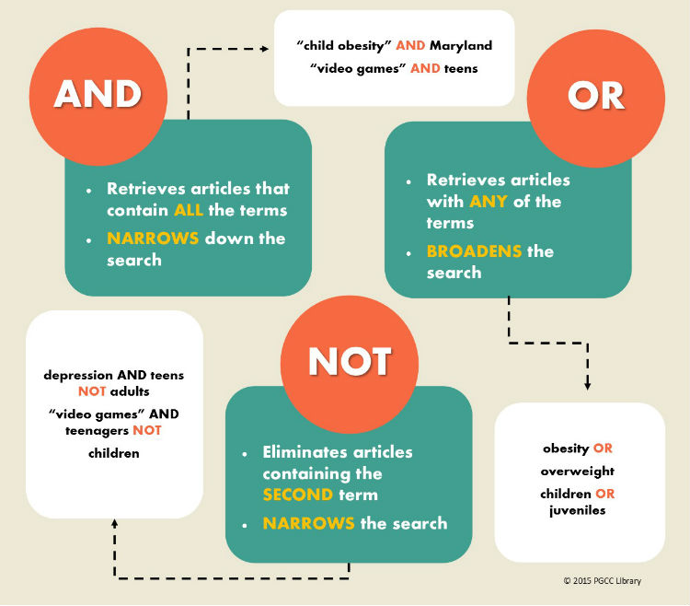
Power searching: Boolean operators

Slide 6
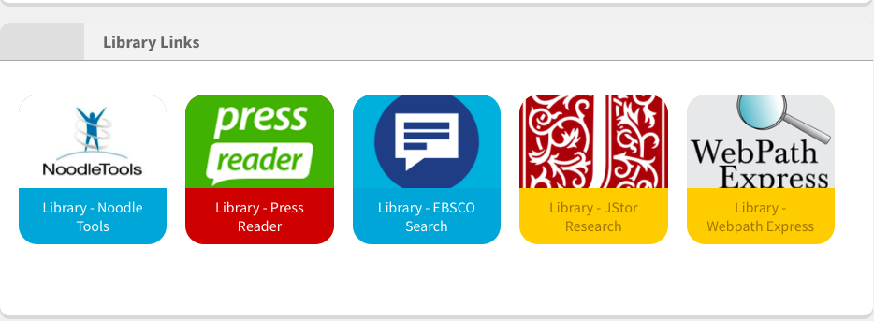
Your Starting Point: Library Links on Firefly
https://dcsg.fireflycloud.asia/student-dashboard

Slide 7
For ANY database
Refine your results
Scan, Cite and Save
Use the advanced search

Slide 8
Introducing JSTOR
Mostly academic articles
Older content
User-friendly search
Covers most areas of study

Slide 9
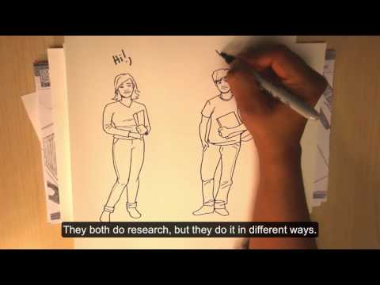
JSTOR (www.jstor.org): Important Features
Access!
Advanced searching
Boolean operators
Search limits
Journal filter
Abstracts
References
Citations
Text analyzer (NEW!)

Slide 10
Step 1: Refine your results

Slide 11
Step 2: Try an Advanced Search

Slide 12
Step 3: Scan, Save and Cite

Slide 13
Step 4: Try the Text Analyser!

Slide 14
Try using the advanced search!
Go to the library links in firefly: https://dcsg.fireflycloud.asia/student-dashboard
Go to the JSTOR tab on the search bar
Search for a topic related to one of your subjects or assignments
Use the advanced search! What happens when you search for:
words or phrases in the abstract?
specific types of sources (articles or books, for example)?
results from specific subject areas/journals?

Slide 15
Introducing EBSCOHost
Newspapers, magazines, and academic journals
Newer content
Clunkier interface
Great first stop
Covers most areas of study
Notes:
Broader range of reading levels

Slide 16
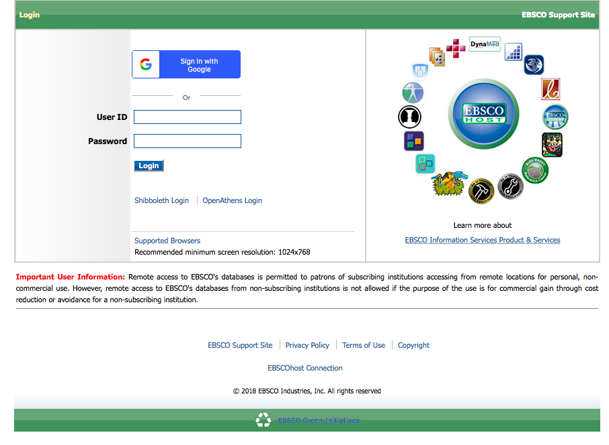
Searching EBSCOHost

Slide 17
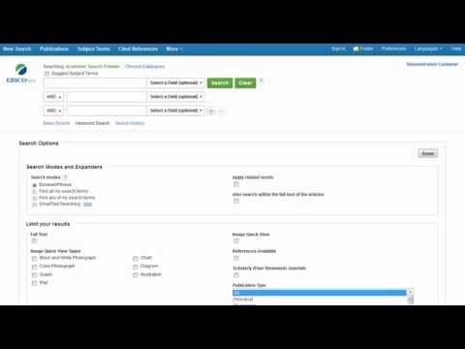
EBSCOHost: Important Features
Access!
Basic Searching (and Refining)
Advanced searching
Boolean operators
Search limits
Images
Abstracts, citations, and saving articles
https://search.ebscohost.com

Slide 18
Step 1: Refine your results
https://search.ebscohost.com

Slide 19
Step 2: Try an Advanced Search
Fields
SmartText Searching
Limits

Slide 20
Step 3: Scan, Save and Cite
abstract

Slide 21
Try scanning, citing, and saving!
Go to library links in firefly: https://dcsg.fireflycloud.asia/student-dashboard
Go to the EBSCO tab on the search bar
Search for a topic related to one of your A-level courses
Pick an article that looks relevant!
Read the abstract (if it has one)
What happens when you click on Find Similar Results?
Email or save the article
Can you find the permalink?

Slide 22
EE Research Skills:
EBSCO and JSTOR databases
Thanks to Kim Beeman, teacher librarian @ Tanglin Trust School for allowing us to adapt this presentation for use at Dulwich College, Singapore

