Slide 1
Title – Exam Technique – Paper 2 - China
Starter questions
Who was in power in China 1900-1911?
Who became leader of China 1912-1916?
Who ruled China 1916-1928?
Who ruled China 1928-45?
When was the Sino-Japanese War, and when was the Chinese Civil War? How do these two events differ from each other?
Challenge - When was the existence of the People’s Republic of China proclaimed by Mao Zedong?
Notes:
Empress Dowager Cixi
Yuan Shikai
Warlords / GMD
GMD and Chiang Kai-shek
1937-45 – Japanese Invasion, 1946-49 – CCP v GMD
Challenge – 1 October 1949

Slide 2
How can you be successful in a China paper?
Focus on explanation and the question in the 16-marker!
Just ANSWER the question!
Use clear topic and link sentences in all answers!
Use precise evidence from both periods in the 6-marker!
Make sure you actually mention your overall opinion in the topic sentences of the essay!
Revise and prepare the ‘causes’ questions beforehand.

Slide 3
Q1a – Explain TWO ways in which __________ was [different/similar] to ______.
6 marks
9 minutes
Paragraph 1 – Make a direct comparison. Then add specific evidence from each period to support the explanation.
Paragraph 2 – Make a different comparison as above.
Remember to EXPLAIN the comparison or contrast – don’t leave it up to the examiner to figure this out on their own!

Slide 4
For example:
A) Explain TWO ways in which the way China was ruled in 1926 was different to how it was ruled in 1900. [6 marks]
One difference in the way China was ruled in 1900 and 1926 was the leadership. In 1900, China was ruled by the Qing Dynasty, made up of Manchu leaders. In 1900 the Empress Dowager Cixi was the leader of China. In contrast, by 1926 China was ruled by many different warlords, each of whom controlled a different area. Therefore, the leadership was split between many in 1926, whereas it was controlled by one individual in 1900.
*repeat with another difference, e.g. the role of the military*

Slide 5
The examiner is looking for...

Slide 6
Q1b – Explain TWO causes of _________.
8 marks
12 minutes
Paragraph 1 – explain one cause
State the overall cause first
Then go into detail to explain how that cause directly led to the event
Link back to the stated cause with a ‘therefore’ sentence
Paragraph 2 – explain a second cause
As above – but must be clearly different

Slide 7
For example:
B) Explain TWO causes of the formation of the First United Front. [8 marks]
One cause of the formation of the United Front in 1924-1927 was the similar aims of the two groups and areas they had in common. For example, Sun Yat-Sen in the GMD had proposed the ‘three principles’ which included the belief in the importance of equality of the people. This was similar to the CCP’s emphasis on ending class division and promoting equality in society. The two groups also shared a similar aim in wanting to end the warlord chaos in China, and therefore hoped the United Front would allow them to work together effectively. Therefore, the cause of the formation of the United Front was similarity in what the two groups wanted.​
*repeat with a different cause, e.g. 30 May Incident 1925*

Slide 8
The examiner is looking for...

Slide 9
Q1c – Essay question. Type 1 (Mocks 2023) – How far did [theme] change in China in the years 19XX to 19XX?
16 marks
25 minutes
This unit comprises five key topics, each centred on crucial developments in the history of this period. The following themes run through the key topics:
Civil conflict – order and disorder
External influences on China
Economic transformation
Social transformation
The role of leadership.
These themes will be the focus of Paper 2, sub-question (c), which will normally draw on the content of two or more topics.

Slide 10
Intro - directly answer the question with reference to 2-3 criteria and three events/periods.
Paragraph 1- Start with first event/period chronologically
Explain the ‘initial conditions’ for each criteria area using this event/period.
Analyse how far there is evidence of CHANGE and CONTINUITY
Use specific detail to support/illustrate each criteria area.
Paragraph 2- Next event/period chronologically
State the extent of CHANGE and CONTINUITY for each criterion.
Support the judgements with specific examples
Link back to the previous event to justify judgements with a ‘therefore’ sentence.
Paragraph 3- Final event/period chronologically
State the extent of CHANGE and CONTINUITY for each criterion.
Support the judgements with specific examples
Link back to the previous event to justify judgements with a ‘therefore’ sentence.
Conclusion- Explain how far there was more CHANGE or CONTINUITY overall, linking to the criteria. Mention which event/period showed the most DRAMATIC change/continuity.

Slide 12
For example:
C) How far did the relationship between China and the Soviet Union change in the years 1911-62?
Finally, in the period 1949-1962 the relationship between China and the Soviet Union changed once more, with a shift towards economic advice as the main type of support, although with continuing mistrust and suspicion. In the early years of the People’s Republic of China, the Soviet Union offered support by sending Soviet experts and advisers to help with the first Five Year Plan, as well as offering loans to support this plan. The relationship therefore had changed significantly from one of military support during times of war, to a relationship based on supporting domestic policies to lead to economic progress. However, after Khrushchev made a ‘destalinisation’ speech in 1956, the relationship between the Soviet Union and China shifted to one of suspicion as Mao viewed the speech as a potential threat to his own power and influence. In 1958 there were two failed diplomatic visits between China and the Soviet Union, and Khrushchev publicly criticized the Great Leap Forward. While this was a change from the period 1949-54, the idea of suspicion between China and the Soviet Union had been true during the Chinese Civil War, so this element of change in the relationship was less significant. Overall, the relationship in this period changed significantly in terms of the type of support offered. Although the relationship was still between the Soviet Union and the CCP, and the relationship still featured suspicion between the two, there was overall a major change as the support shifted to primarily economic and political support rather than anything relating to war.
*plus intro, two other paragraphs, conclusion*

Slide 13
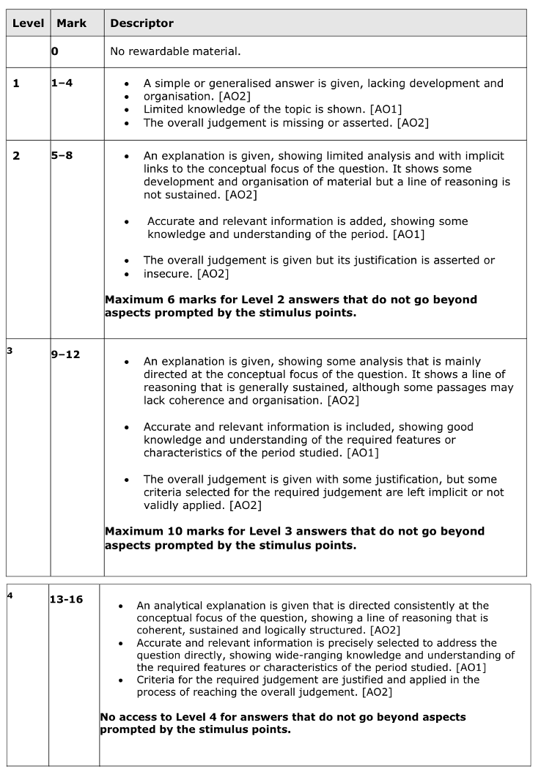
The examiner is looking for...

Slide 14
Things you could do that would be sensible:
Look at the specification and focus on your weakest topics
Revise exam technique and make sure you know how to answer each type of question
Plan predictable questions/themes (or use the summary questions at the end of each section in the textbook to help you)
Look back at previous exam questions and read my feedback so that you don’t make the same mistake twice
Take active and condensed notes from the textbook or online revision guide
Black-pen-green-pen mindmaps
Timelines (although don’t obsess over this, it’s often not actually that useful)
Use online flashcards e.g. Quizlet, Seneca

Slide 15
What you need to know overall:

