Slide 1
Red Dot Winners
Early Years
1st place
2nd place
3rd place
2016-2017

Slide 2
Red Dot Winners
Younger Readers
1st place
2nd place
3rd place
2016-2017

Slide 3
Red Dot Winners
Older Readers
1st place
2nd place
3rd place
2016-2017

Slide 4
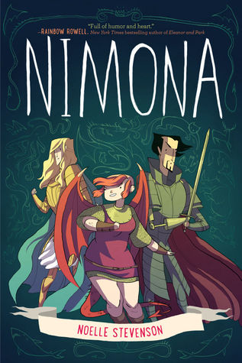
Red Dot Winners
Mature Readers
1st place
2nd place
3rd place
2016-2017

