Slide 1
And a hero comes along

Slide 2
— Bob Riley
“Hard times don't create heroes. It is during the hard times when the 'hero' within us is revealed.”
In other words, - hard times don't create heroes, but it's during the hard times that we begin to see who the real heroes are.

Slide 3
Call to action
Books about heroes – what do you notice?

Slide 4
Heroic tales from girls around the world who didn't give up their dreams, even when everything seemed against ...

Slide 5
Summarise the important points in one of the stories by answering the following questions using your own words: Why is this person a hero? What called her to take on the challenge? What obstacles, problems or difficulties did she need to overcome? What are her future dreams to continue to make the world a better place?

Slide 6
Paraphrasing information – a 4 step approach

Slide 7
Step 1 – read the passage out loud with comprehension in mind
What is this trying to say?
Create an “imperfect” initial verbal restatement of the main idea.

Slide 8
This passage talks about the achievements and difficulties faced by Polish born scientist Marie Curie. We learn that after studying at the Sorbonne she made ground-breaking discoveries in the field of radioactivity. But despite her outstanding career she came up against people who questioned the validity of her findings.

Slide 9
Step 2 – note down all the important words and phrases that you think may be useful when you rewrite the passage in your own words
However, in your rewrite it is not necessary to use all the words and phrases selected

Slide 10
Marie Currie, Poland, chemistry, maths, physics, radioactive material, discovered polonium and radium, Sorbonne University, two Nobel prizes, commemorated in France's Pantheon mausoleum

Slide 11
Step 3 – decide on a new structure for your paraphase
Change the sentence structure so your paraphrase begins differently to the original.
The passage starts by describing all Marie Curie's achievements and then highlights the difficulties she faced. Why note swap these two focuses around!

Slide 12
The important work and discoveries made by Polish born scientist, Marie Curie, were initially called into question by others who believed she was incorrect (possibly because she was a woman). Studying and working in the field of radioactivity, Curie discovered polonium and radium and was the first woman to:
Become a professor at the Sorbonne
Win two Nobel prizes
Be commemorated in France's Pantheon mausoleum

Slide 13
Step 4 – Add a citation
The important work and discoveries made by Polish born scientist, Marie Curie, were initially called into question by others who believed she was incorrect (possibly because she was a woman). Studying and working in the field of radioactivity, Curie discovered polonium and radium and was the first woman to:
Become a professor at the Sorbonne
Win two Nobel prizes
Be commemorated in France's Patheon mausoleum
(Blanchard 27–28)

Slide 14
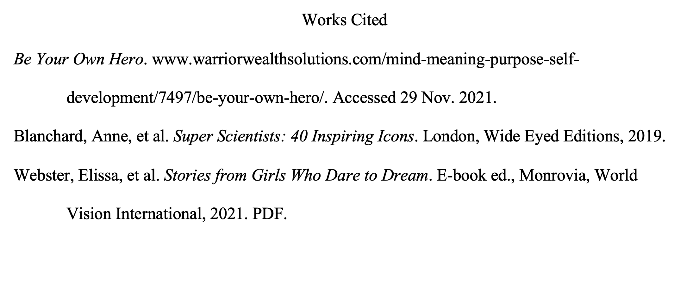

Slide 15
You've got this!

Slide 16
