Slide 1
Religion – FYI!
The historian Richard J Evans wrote that, by 1939, 95% of Germans still called themselves either Protestant or Catholic, while 3.5% identified as "gottgläubig" ("believers in god", a non-denominational nazified outlook on god beliefs, often described as predominately based on creationist and deistic views) and 1.5% atheist.

Slide 2
Title – How do I answer Germany exam-style questions?
Starter questions
When did WWII begin?
Who were the 'November criminals'?
Which agreement involved seven treaties to accept the new western borders of Germany?
When was the Wall Street Crash?
Name one opposition group to the Nazi regime.
Challenge - When was the Night of the Long Knives and how did it help Hitler to consolidate his power?

Slide 3
Title – How do I answer USA exam-style questions?
Starter questions
When did Nixon resign?
Which protest led to the emergence of Martin Luther King as a leader?
What was MLK's group called?
What did Joseph McCarthy do?
Which war did the student movement oppose?
Challenge - What was, in your opinion, the most significant outcome of the Watergate scandal?
Notes:
1. August 1974
2. Montgomery Bus Boycott
3. SCLC – Southern Christian Leadership Conference
4. Red Scare
5. Vietnam War

Slide 4
TIMING!
45 minutes in total
Q1a – 6 marks, 9 minutes
Q1b – 8 marks, 12 minutes
Q1c – 16 marks, 24 minutes

Slide 5
Q1a – 6 marks, 9 minutes Analyse and evaluate a historical interpretation.
Two paragraphs
Paragraph 1 – what is the impression?
Sum up what the author is trying to say in one sentence - The impression the author gives of X is…
State any key points or sub-points IN YOUR OWN WORDS – use small quotes to show where the points are made
Paragraph 2 – how has the impression been made?
How has the author made the impression? Mention the tone and language used
Comment on content (What has the author chosen to emphasise or leave out? Why? How does that affect the impression?)
You can include own knowledge here to support your point

Slide 7
The examiner is looking for...

Slide 8
A full marks answer looks like this:

Slide 9
Q1b – 8 marks, 12 minutes Explain two effects of ... on ...
Useful Vocab:
Led to
Due to this,
Resulted in
Consequently
This meant that
As a result
This was because
Following on from this
The effect of this was
The impact of this was
Hence
Subsequently
Two paragraphs
EXPLAIN AND DEVELOP each effect
Focus on the LINKS
Use 'because'
The effects must be DIFFERENT

Slide 10
The examiner is looking for...

Slide 11
A full marks answer looks like this:

Slide 12
Q1c – 16 marks, 24 minutes 'Statement'. How far do you agree?
Short introduction – overall opinion, criteria, points to discuss
Paragraph 1 – stimulus point 1 (link to Q and criteria)
Paragraph 2 – stimulus point 2 (link to Q and criteria)
Paragraph 3 – own knowledge point (link to Q and criteria)
Conclusion – link to criteria, make overall judgement clear
Include specific evidence – dates, names, places, policies etc.
Focus on developing judgements and linking to the QUESTION!

Slide 13
The examiner is looking for...

Slide 14
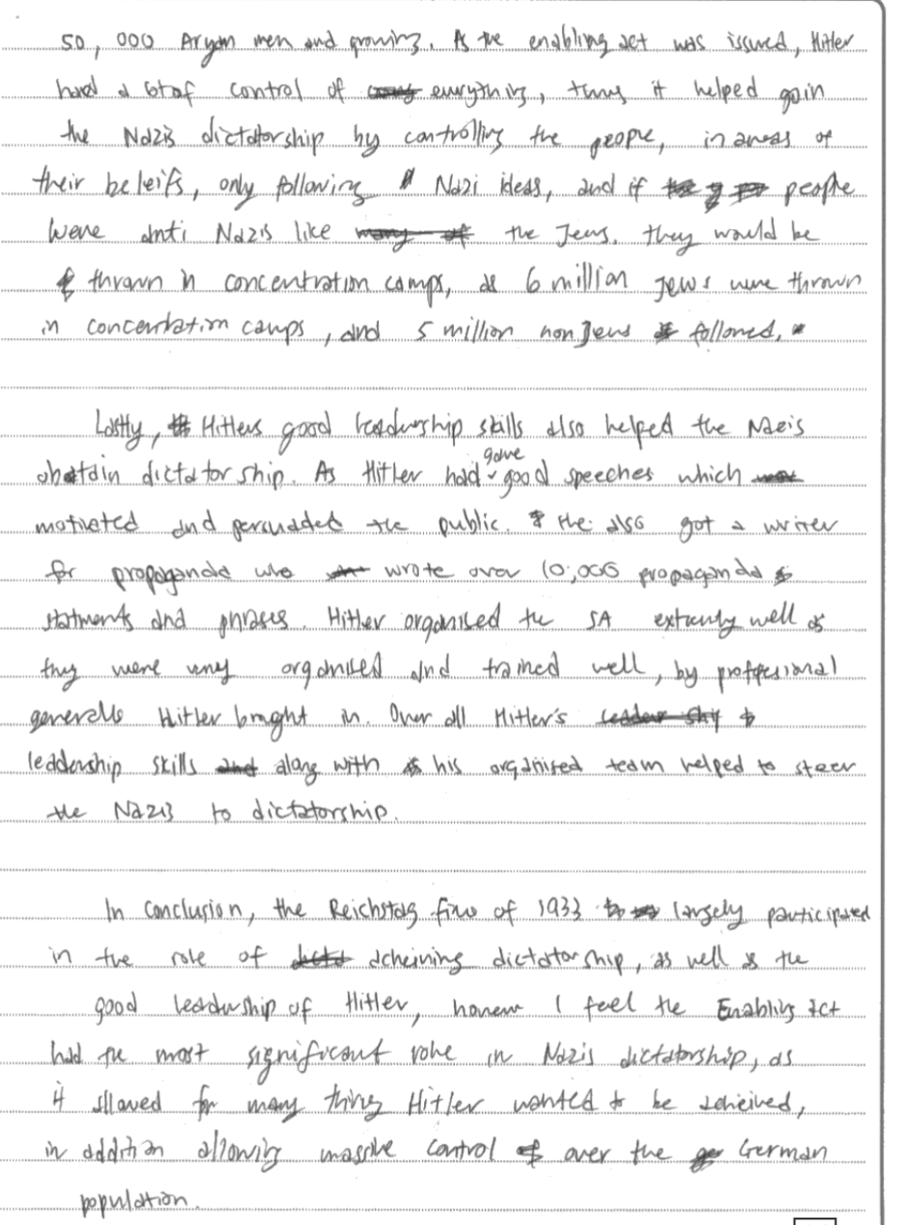
A full marks answer looks like this:

Slide 15
Quizizz:
https://quizizz.com/admin/quiz/5f7ea85412b8c6001e42cace/igcse-paper-exam-technique
https://quizizz.com/admin/quiz/601ccd975b51ea0020db9d07/usa-recap-up-to-montgomery
https://quizizz.com/admin/quiz/5f4cba18a21296001b2dfa5a/usa-recap-topics
https://quizizz.com/admin/quiz/5eb7a94968dc16001b7e919c/igcse-history-usa-s
https://quizizz.com/admin/quiz/5e9967cb719106001e90e3c3/igcse-history-usa-s
https://quizizz.com/admin/quiz/5f8ea383e90617001b8fd6c6/the-other-protest-movements
https://quizizz.com/admin/quiz/5f9780d8d35cf7001be1b98b/igcse-history-usa-overview

