Slide 1
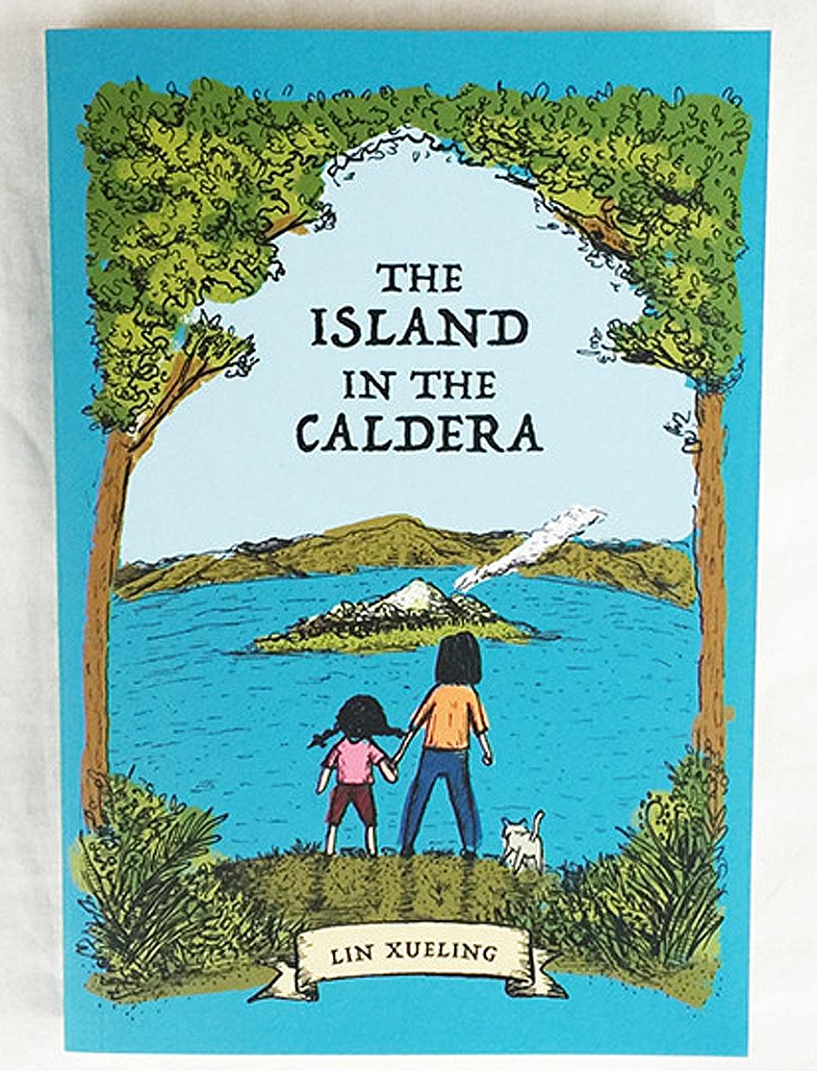
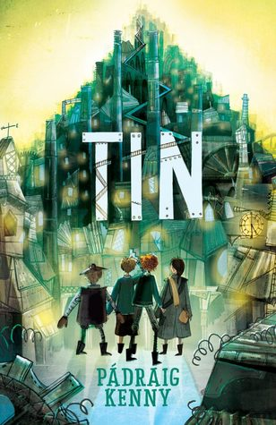
Design a Better Book Cover for a Red Dot Book
2018-2019
Matured Readers Older Readers
All Students may submit a ‘Better Book Cover’ to be judged during the Nationwide Readers’ Cup Festival. Please submit your cover to the library on time. You may draw by hand or use digital images, as long as they are allowed to be used and are from ‘Creative Commons’ or another public domain.
Librarians will chose the best 3 from each category to be entered in
the competition. Prizes to be won! Please follow the criteria below and if you have any questions ask your librarian.
Due date: 25th March 2019
Checklist
A4
Font is easy to read
All essential information is visible (title, author and illustrator)
Images have a good connection to the story
Work is neat and reflects knowledge of the book
Images from the internet must be given credit by listing the URL on the back of the cover
Images found on the internet must be royalty free and follow the
proper usage rights

