Slide 2
Thursday 2nd March
ALL WEEK
Buddy reading – across the College during your English class
Teachers sharing - 'What I'm currently reading' - outside their classroom doors
Earn a house point for every book borrowed during Book Week
Construction of 'Best Book Ever' Wall – in the library – earn house points
Favourite Illustrator Gallery – vote for your favourite and earn a house point
World Book Day doodle colour design competition – be creative and earn house points
Great first lines in books activity
And many other house point scoring, book loving activities …

Slide 3
Monday 27 February
Welcome back to an exciting week of doing 'booky' things!
DEAR – Drop Everything and READ!
Make sure you have a book with you at all times today as we will all be stopping what we are doing 3 times during the day and
READING!

Slide 4
Tuesday 28 February
Tutor group multiple choice book quiz – answer provided tomorrow – house points! Send a representative from your tutor group to the senior library with your answer sheet.
Match the book characters: all staff to have the name of a book character on their lanyard. Students to identify as many as possible and submit results to the library for house points. Entry forms available at the senior library
Author Talk - 12-12:50pm in the Performing Arts Theatre – Singapore based authors of the Red Dot Award Book Secrets of Singapore, Lesley-Anne & Monica Lim will present to years 5, 6, 7 and 8!.Buy a book and have it signed by the authors!

Slide 5
Wednesday & Thursday
Book Fair
Senior School Library
Open before and after school and lunchtime.

Slide 6
Wednesday March 1st
Share-a story
A story will be split into seven sections (one section for tutor time and one for each lesson) to be read for about 5 – 10 minutes in all of the subjects across the day!
READING!

Slide 7
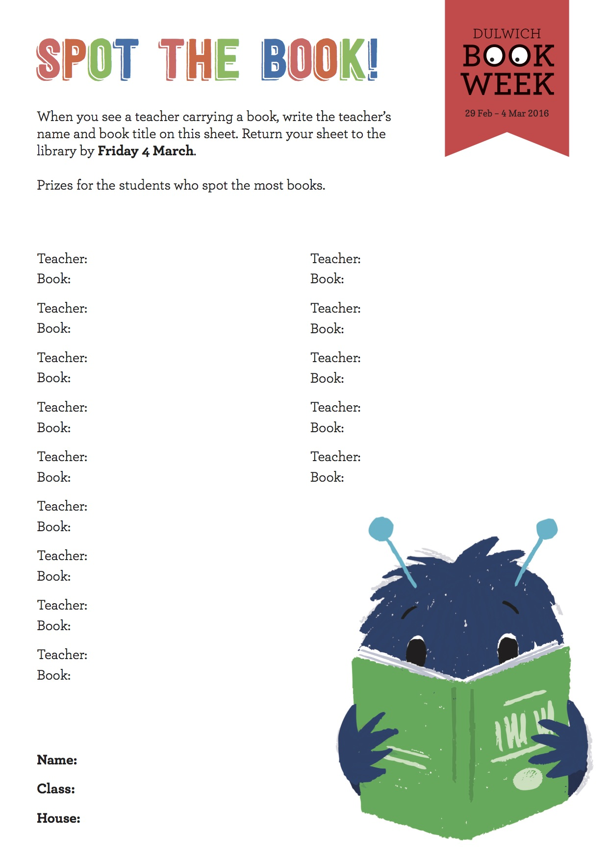
Thursday 2 March
Watch the World Book Day video
Come to the library and have your photo taken with a Dr Seuss quote – today is the anniversary of his birthday – house points!
Spot the Book - see how many staff are carrying a book with them on THURSDAY- grab an entry form from the library and submit for house points!

Slide 8
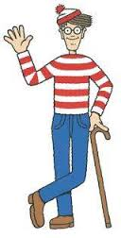
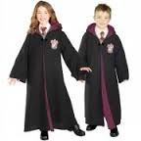
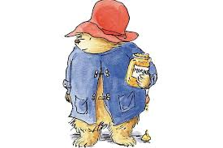
Friday March 3rd
Dress Up Day
Dress up as a book character and
Donation of $1 for our sister school in Cambodia - $2 if don't dress up!
House points for interesting costumes – make sure you come to the senior library to collect!
Your tutor teacher will collect your donation and a rep from your group will it to the senior library.

