Slide 1
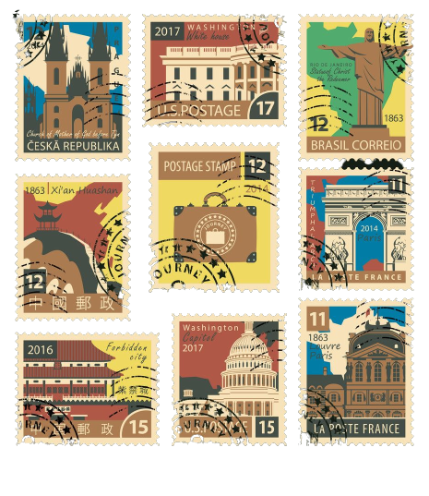
A Guide To Stamp Collecting

Slide 2
Why do people collect stamps?
Ever since stamps were introduced in 1840, stamp collecting has consistently been one of the most popular hobbies in the world for many reasons. It is, for the most part, a relatively easy hobby to delve into; with such a vast array of prints, there really is something for everyone. From the affordable to the rare and expensive, the hobby allows anyone to build their own collection in any way they wish, producing something that anyone would be proud of.

Slide 3
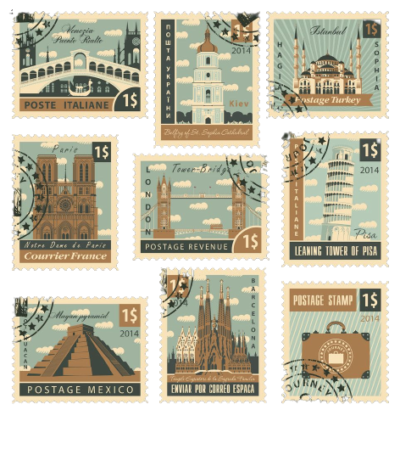
What is a stamp collector called?
The correct name for a stamp collector is exactly that, a stamp collector. As you begin to find out about stamp collecting, you may see collectors being referred to as "philatelists". While this is not entirely untrue, philately refers to the study of stamps and therefore does not always involve collecting. However, it is not uncommon for the term "philatelist" and "stamp collector" to be used interchangeably.

Slide 4
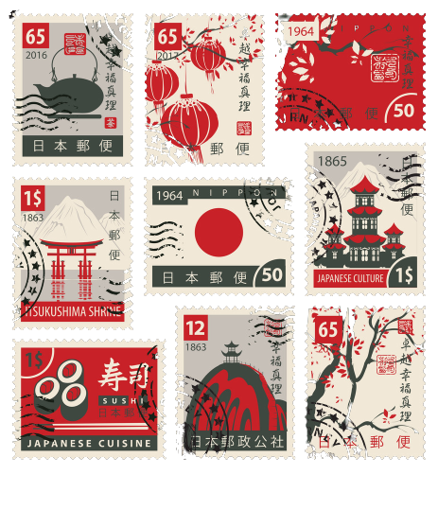
Should I start collecting stamps?
Stamp collecting in the modern day is still one of the most popular hobbies in the world, with more than 20 million collectors globally!
Stamp collecting as a hobby doesn’t need to take up lots of your time or money and there are fantastic communities across the world with whom to share this fun and fascinating passion with. Whether you want a hobby that you can partake in on the occasional weekend or really dive into, stamp collecting could certainly be that for you. The fantastic appeal of stamp collecting is you are entirely independent in how fast you acquire your stamps and how far you take your collection. If you have a lot of disposable income, you could certainly build up a high-value stamp collection faster. However, that is neither the goal for many collectors nor is it necessarily the way you are going to best enjoy collecting stamps. With so many variations around the world, your stamp collection can be anything you want it to be!

Slide 5
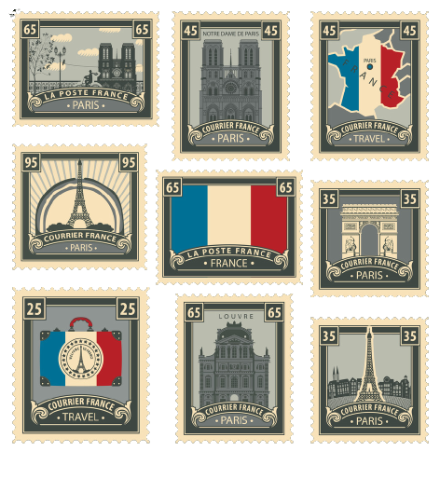
How to start a stamp collection
The beauty of collecting stamps is that it takes as much time and effort as you are willing to put into it. However, there are a few things you may want to consider when looking to start your collection. See below for our top tips on how to get started...

Slide 6
1. Acquiring your stamps
To start off your collection, unless you have a specific theme in mind already, a great way to get a base is to buy the largest packet of whole-world stamps you can afford. You can also gather stamps through friends and family abroad, from old letters. If you’re very lucky to have inherited a set of albums from a generous relative, use it as a foundation for a much larger collections.
Expert tip: Store your collection in a stock book to keep your stamps in order and in good condition.

Slide 7
2. Choose what condition of stamps to collect
The stamps that you gather may be varied in condition if you buy collections or packets and you are also bound to acquire a good percentage of quite common stamps. At this point, you can choose if you want to collect used or unused stamps, or of course, you can collect both, but know that unused stamps are worth dramatically more than a used stamp.

Slide 8
• Used stamps
Have had postal, telegraphic or fiscal use and have been cancelled accordingly. These are usually cheaper and easier to find.
• Unused stamps
Have not been used in the post and are consequently not postmarked or otherwise defaced. They should have their original gum as issued in ‘mint’ condition by the post office, though traces of the use of a gummed hinge are generally acceptable.
• Fine-used stamps
Have postmarks that are light, but have sharp and clear distinctions. Heavy black cancellations that obliterate the stamp’s design are entirely unacceptable. Some postmarks, especially early types (prior to 1920) from military camps, railway stations and ship cancellations, etc. are often more valuable than the stamps, especially if kept intact on the original cover.
Important to note: Be careful not to discard any items from your collection too hastily. You may, at a later date, switch to collecting only the stamps of a certain country or group of countries where even the common stamps may be needed to form the nucleus of a collection.

Slide 9
3. Choose themes for your stamp collection
One of the most appealing things about stamp collecting is that you can literally pick anything to base your collections around, you can collect only yellow stamps, stamps with chickens on or even just triangular stamps. Let your imagination run wild. Stanley Gibbons has found that most traditional collections break down one of three ways, either by monarch, country or rarity and value. With that in mind, we have gone into a little more detail on some of these areas below:

Slide 10
• Iconic Stamps
Some stamps find their way into every collector's albums. Stanley Gibbons consider some items as iconic to the hobby of stamp collecting, representing significant historical moments or new technological developments.
• Monarch Stamps
Monarchs symbolise Great Britain's evolution through times of advancement and struggle. Succession, abdication, war and prosperity, all frozen in time in the stamps that marked those moments.
• By Country
You could learn about a country's leadership, history, flora and fauna all through studying its stamp designs and representations. Some of the most popular items include Australia's Kangaroo stamps, the Whale and Penguin stamps from the Falkland Islands and the Desert Postman stamps of Sudan.

Slide 11
4. Learn to identify stamps
A stamp catalogue is a stamp dealer’s price list and is the most essential work of reference for the stamp collector. A stamp catalogue provides complete, detailed lists of all the postage stamps issued by every country in the world from the earliest days. Collectors use the catalogues as guides to assess whether a set of stamps can be completed or how stamps should be arranged in an album. It also helps collectors become more acquainted with their colours and names. The most useful catalogue for the beginner is the Stanley Gibbons Simplified Catalogue of Stamps of the World, published in six volumes. Countries in Stamps of the World are arranged in alphabetical order, from Abu Dhabi to Zululand. There are also single volume Commonwealth Simplified and Western Europe Simplified Catalogues, following the same format, for those whose collecting area is more restricted. Commonwealth and British Empire Stamp Catalogue 1840–1970 includes all stamps of this area from the earliest issues up to the end of George VI’s reign and additionally lists and illustrates many of the better varieties popular with collectors. Catalogues like the Great Britain Concise and Collect British Stamps show all the new issues and latest prices.

Slide 12
5. Buy the essential tools for stamp collecting
Generally, with stamp collecting, the stamps themselves will be the more costly aspect, rather than the equipment you need to care for and store your stamp collection. However, there are some basic tools that will make collecting stamps a lot easier, and more efficient, such as…

Slide 13
Stamp Tweezers
An essential item of equipment – these are made of light, plated metal with slender, flattened tips or ‘spade’ ends enabling stamps to be picked up and sorted quickly and surely. Beginners must be careful with stamp tweezers so as to avoid piercing their stamps when handling them.
Stockbooks or Binders
A stockbook or binder is designed to store your stamp collection within its pages. Stockbooks are bound and sometimes have mounts on their pages with which to temporarily attach your stamps A binder is essentially a ring folder that you can add pages to, so they are great if you’re not sure how large your stamp collection is going to be yet as you can just buy more pages, or ‘leaves’ as they are sometimes called. Remember, your stamps should never be permanently affixed to the pages of your stockbook or binder, so you can always upgrade if you find your existing solution isn’t working for you.
Stamp Catalogues
As mentioned before, stamp catalogues are an essential piece of kit for stamp collectors of all levels. They allow you to identify stamps and establish which stamps you will need to further your collection within your theme.
Stamp Magnifying Glass
With a magnifying glass, you can see the lines or cuts which make up a portrait or scene on an engraved stamp or study the quality and peculiarities of other printing processes such as the graduated ‘dots’ of photogravure or the smooth honeycomb background of lithographed stamps.

Slide 14
5. More advanced stamp collecting
tools
Once your interest and ability in stamp collecting advances, charting the flaws of stamps will start to be of more interest to you.
Perforation gauge The perforation gauge measures the number of perforations within the measure of 2 centimetres. Perforations are a stamp’s ‘teeth’ and their measurements vary according to the type of perforating machine used. Often the stamp’s top and bottom ‘perfs’ differ from those at the sides (called a ‘compound perforation’), and measurements range from 7 (large holes) to about 18 (small holes).
Watermark detectors
The watermark is simply a thinning of the paper in the form of letters or an emblem such as a crown, and it can usually be seen when the stamp is held with the light shining through it, or if the stamp is placed face down on a dark – preferably black – surface. The main instrument for detecting stamp watermarks is the human eye. However, if a watermark is not visible, then you have to use scientific aids like watermark detectors. Remember that the watermark is the ‘right way round’ when viewed through the front, and in reverse when viewed through the back.

Slide 15
Storing and caring for your stamp collection
You have gathered your stamps, chosen the condition of stamps to collect, read about your area or theme of interest, identified your stamps and assembled a tool kit. Now, it is time to store and display your stamp collection...

Slide 16
How to store your stamps
1. High and dry
When storing your stamp collection it’s important to use acid-free paper, high up in a dark dry space. This should protect your collection from other family members, UV damage, mould, air moisture and water damage. Popular choices are safes, wine coolers and cupboards with moisture-sensitive silica gel capable of both absorbing and desorbing moisture placed inside.
2. Choose a stamp album
Depending on what stamps you have decided to collect, choose an appropriate stamp album size. Unless you have a large collection or anticipate buying many more stamps, it is sensible to start with a modest size stamp album. The only concern being that with a far too large album, your existing stamps will be greatly extended and give your collection a sparse appearance.
3. Put your collection in your stamp album
Gummed stamp hinges attach the stamp to the album pages – just fold down about a quarter of the hinge, gummed side outwards, and lightly moisten the narrow folded portion with the tip of your little finger. Attach this portion to the back of the stamp at the top, just below the perforations, and then moisten the lower part of the ‘flap’ and place the stamp in its appropriate place and press down.

