Slide 1
Red Dot Award Books
Mature Reader

Slide 2
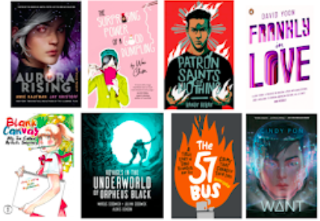

Slide 3
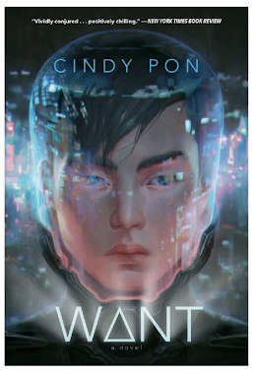
Want – Mature Reader
From critically acclaimed author Cindy Pon comes an edge-of-your-seat sci-fi thriller, set in a near-future Taipei plagued by pollution, about a group of teens who risk everything to save their city.

Slide 4
The Surprising Power of a Good Dumpling
Anna Chiu has her hands pretty full looking after her brother and sister and helping out at her dad's restaurant, all while her mum stays in bed. Dad's new delivery boy, Rory, is a welcome distraction and even though she knows that things aren't right at home, she's starting to feel like she could just be a normal teen. But when Mum finally gets out of bed, things go from bad to worse. And as Mum's condition worsens, Anna and her family question everything they understand about themselves and each other. A nourishing tale about the crevices of culture, mental wellness and family.

Slide 5
Patron Saints of Nothing – Mature Reader
A powerful coming-of-age story about grief, guilt, and the risks a Filipino-American teenager takes to uncover the truth about his cousin’s murder.
Samkad’s village…

Slide 6
Blank Canvas: My So-Called Artist's Journey Vol. 1 – Mature Reader
The autobiographical manga by Eisner-winner Akiko Higashimura, the creator of Princess Jellyfish and Tokyo Tarareba Girls, about her high school dream to become a comic book creator!

Slide 7
Voyages in the Underworld of Orpheus Black – Mature Reader
With otherworldly paintings by Alexis Deacon depicting Harry’s surreal descent further into the depths of hell, this eerily beautiful blend of prose, verse, and illustration delves into love, loyalty, and the unbreakable bonds of brotherhood as it builds to a fierce indictment of mechanised warfare.

Slide 8
The 57 Bus – Mature Reader
If it weren’t for the 57 bus, Sasha and Richard never would have met. Both were high school students from Oakland, California, one of the most diverse cities in the country, but they inhabited different worlds. Sasha, a white teen, lived in the middle-class foothills and attended a small private school. Richard, a black teen, lived in the crime-plagued flatlands and attended a large public one. Each day, their paths overlapped for a mere eight minutes. But one afternoon on the bus ride home from school, a single reckless act left Sasha severely burned, and Richard charged with two hate crimes and facing life imprisonment. The case garnered international attention, thrusting both teenagers into the spotlight.

Slide 9
Frankly in Love – Mature Reader
Two friends. One fake dating scheme. What could possibly go wrong? Frank Li has two names. There’s Frank Li, his American name. Then there’s Sung-Min Li, his Korean name. No one uses his Korean name, not even his parents. Frank barely speaks any Korean. He was born and raised in Southern California. Even so, his parents still expect him to end up with a nice Korean girl–which is a problem, since Frank is finally dating the girl of his dreams: Brit Means. Brit, who is funny and nerdy just like him. Brit, who makes him laugh like no one else. Brit . . . who is white.

Slide 10
Aurora Rising – Mature Reader
The year is 2380, and the graduating cadets of Aurora Academy are being assigned their first missions. Star pupil Tyler Jones is ready to recruit the squad of his dreams, but his own boneheaded heroism sees him stuck with the dregs nobody else in the Academy would touch. And Ty's squad isn't even his biggest problem - that'd be Aurora Jie-Lin O'Malley, the girl he's just rescued from interdimensional space. Trapped in cryo-sleep for two centuries, Auri is a girl out of time and out of her depth. But she could be the catalyst that starts a war millions of years in the making, and Tyler's squad of losers, discipline-cases and misfits might just be the last hope for the entire galaxy.

