Slide 1
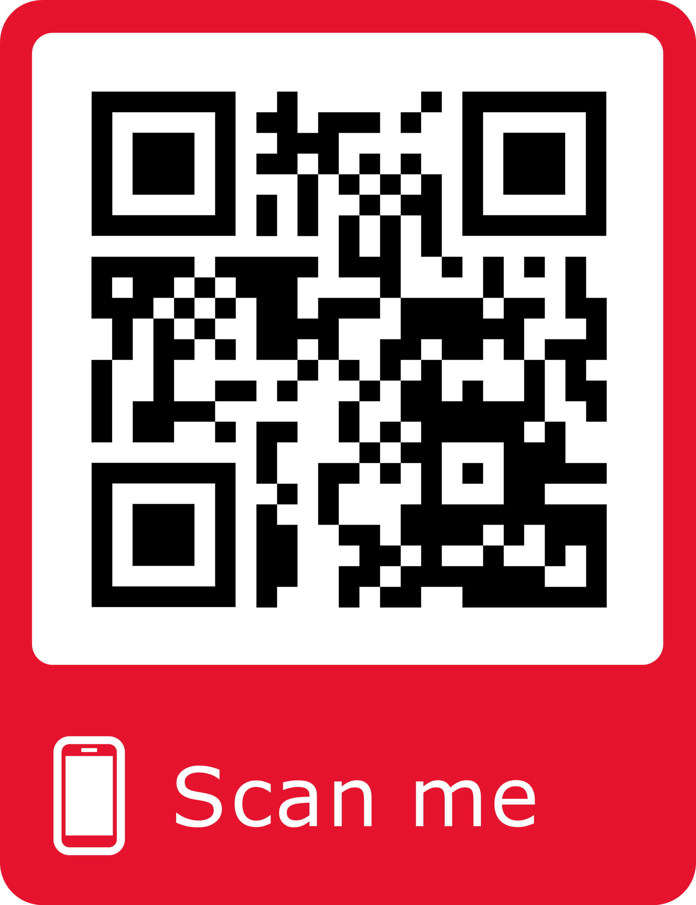
Scan the QR Code below to access Senior School Library’s Recommended Reading Lists!
Scan Me

Slide 2
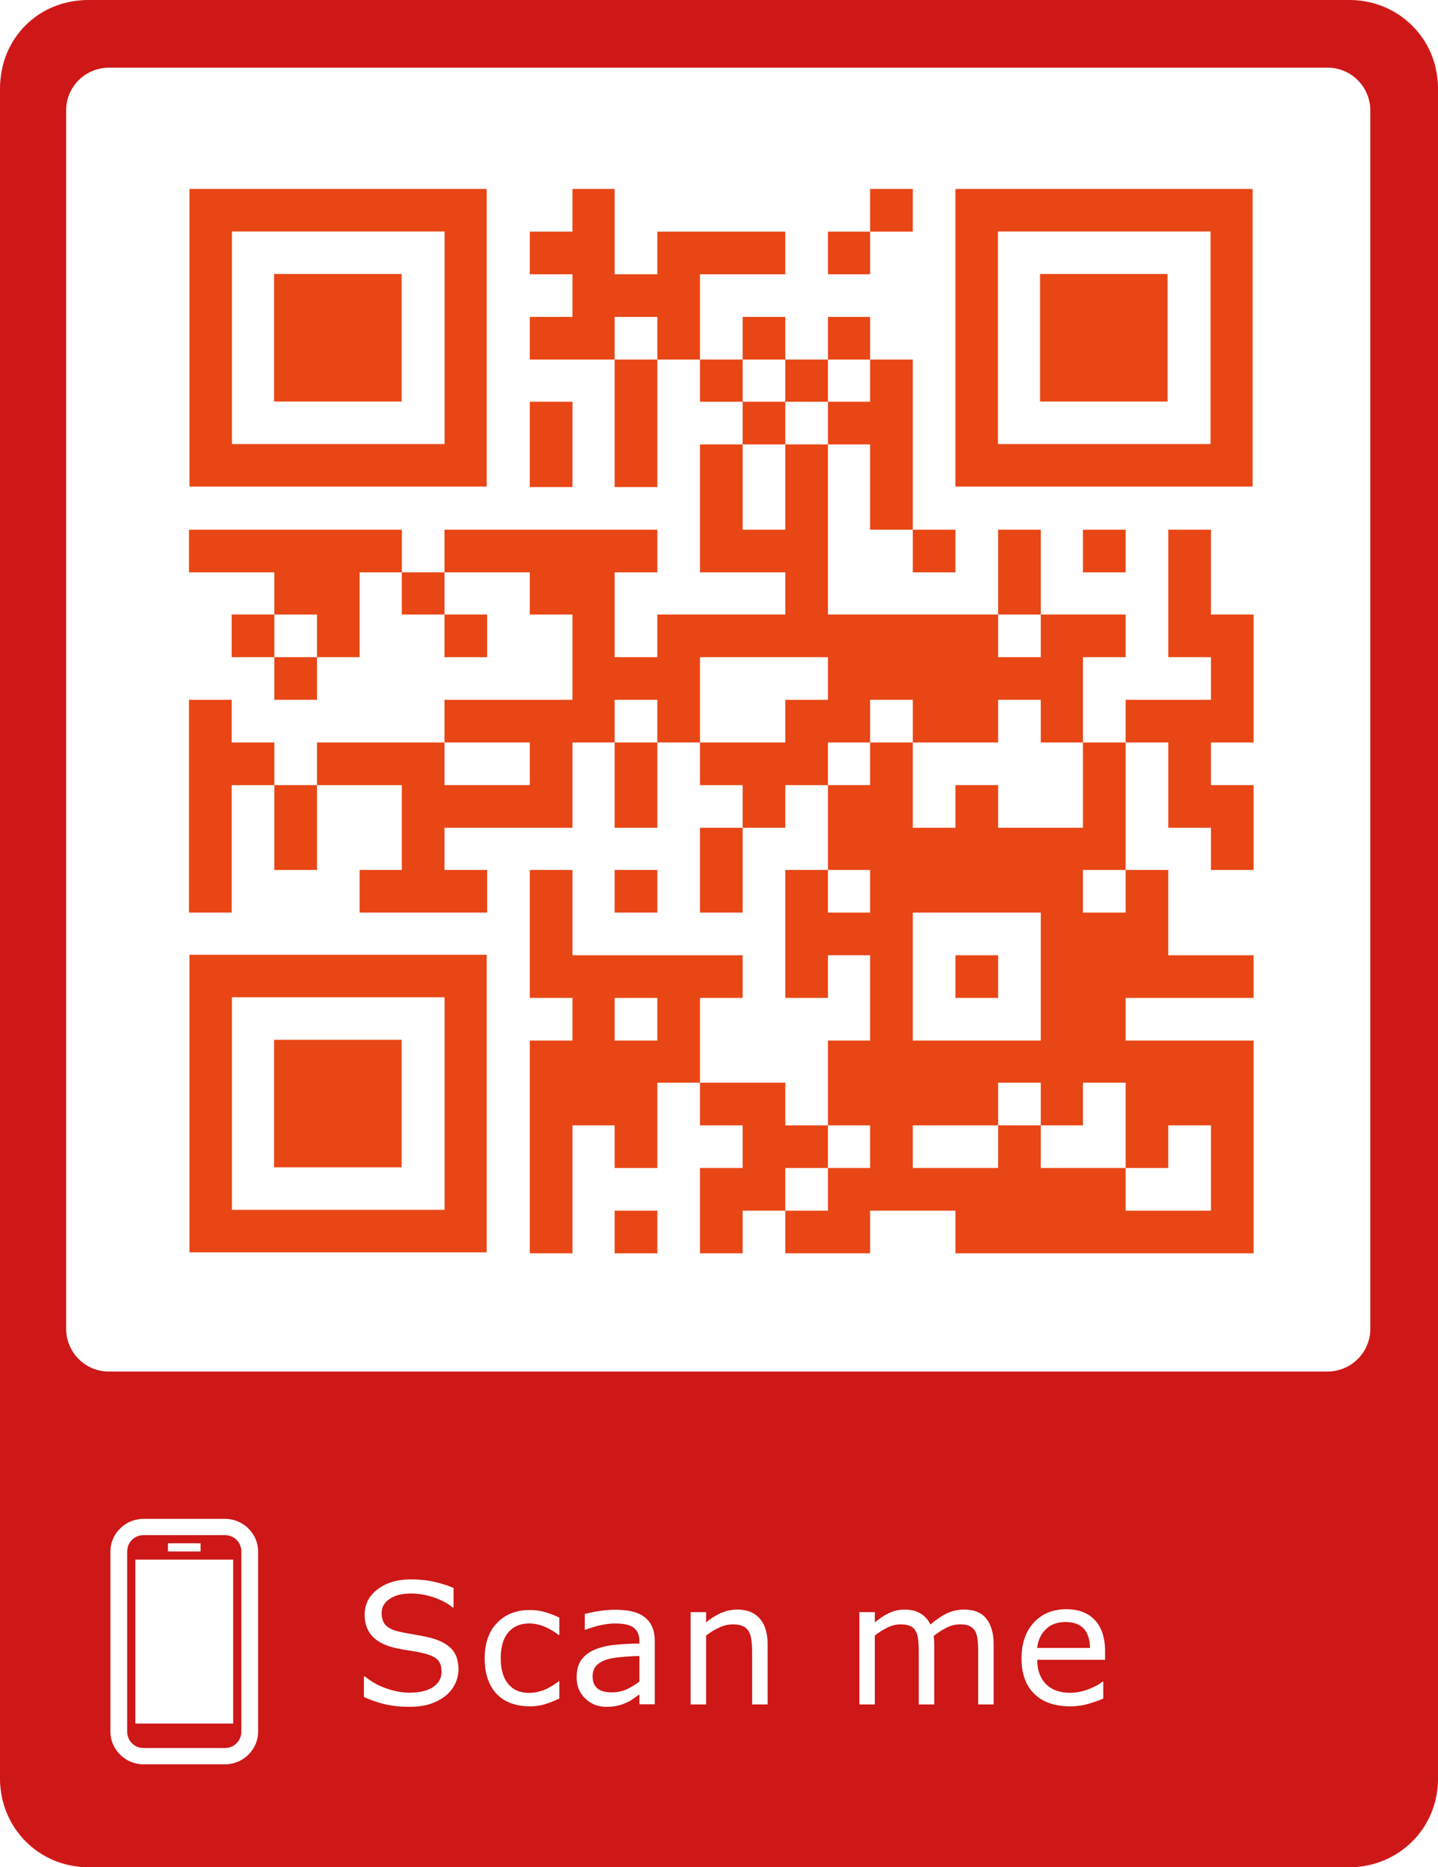
Scan the QR code below to access the Senior School Library’s Destiny webpage!​
You Can :
✔ Explore our collection​
lists!​
​
✔ Find out our latest​
and popular titles!​
​​
✔ Check out our​
e-books!​
Scan Me

