Slide 1
https://reddotawards.com
2021-2022 OLDER Shortlists
These slides: https://bit.ly/reddot-older-2021-2022-hyperdoc

Slide 2
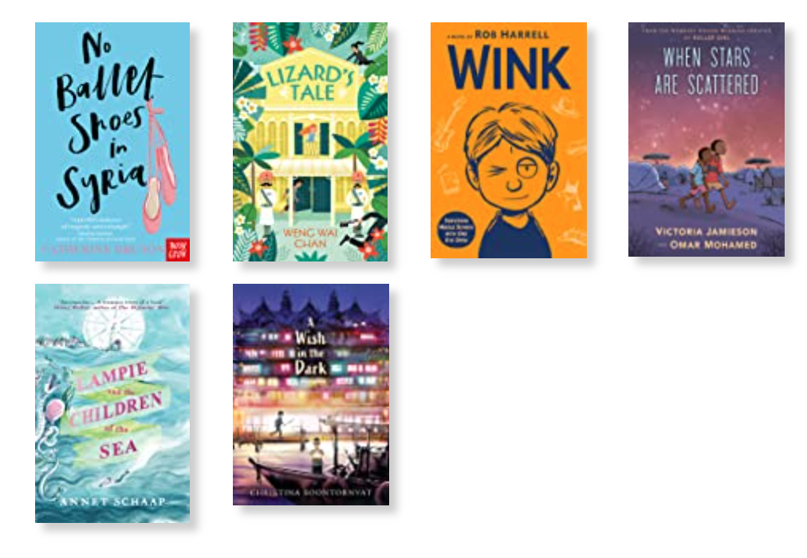
Older
Goodreads link to list

Slide 3
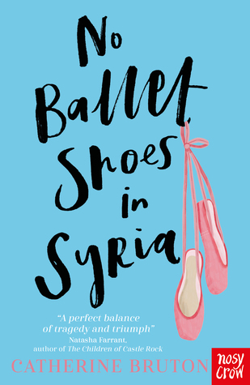
A Syrian refugee finds herself culturally lost in the UK – until she discovers a ballet class that offers a connection between her old home and her new one.
Realistic Fiction (UK)
OLDER

Slide 4
The author introducing the book in a video: https://www.youtube.com/watch?v=PN2RATsZmFk
BBC Bitesize Lesson based on the book: https://www.bbc.co.uk/bitesize/articles/zvwr47h
Read-a-likes / Read ons:
The Boy at the Back of the Class - Onjali Q. Rauf (UK)
Boy, Everywhere - A.M. Dassu (UK)

Slide 5
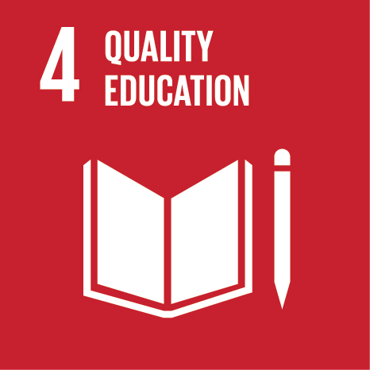
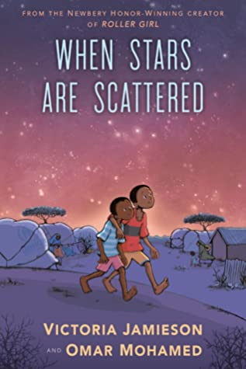
The true story of two Somali brothers living in a refugee camp in Kenya - and the struggle to go to school
Graphic memoir (Kenya)
OLDER

Slide 6
Read-a-likes / Read ons:

Slide 7
WWII spies in Singapore
Danger, adventure, and friendship between a Chinese/British boy and two girls, Chinese and British
Historical fiction (Singapore)
OLDER

Slide 8
Author Reads from Lizard’s Tale
Link to a list of resources related to Singapore history and and images from the 1940s
Q&A with Weng Wai Chan re her upbringing - https://www.betterreading.com.au/kids-ya/sharing-cultural-history-qa-with-weng-wai-chan/
Questions:
Which bits of the book are NOT historically accurate/true?
“New East India Company”?
Gandhi speaking in Singapore?
Glossary at the end:
Investigate some of the words listed
Food from the story:
Roasted rice green tea (genmaicha)
Curry puffs (how many different kinds are there?)
Ovaltine
Claypot fish head soup

Slide 9
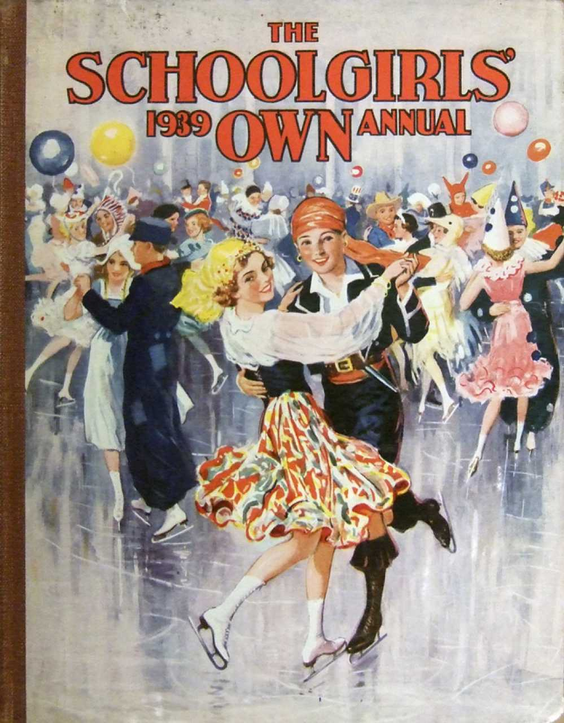
Read ons:
The Ghost Who Pinched Me - Mabel Gan (Singapore WWII)
Languages spoken in Singapore - mentioned in the book:
English, Cantonese, Japanese, Hoikkein, Mandarin,
Historical brand names mentioned in the book:
Brylcreem
Ovaltine
Landmarks mentioned in the book:
Raffles Hotel
Chinatown
Changi Prison

Slide 10
Both traumatic and hilarious -- re a boy dealing with a rare eye cancer diagnosis in middle school
Based on the author’s own experience
Realistic fiction (USA)
OLDER

Slide 11
Author website: https://robharrell.com
New RELATED book coming out in October 2021: a Bat-Pig graphic novel: https://www.goodreads.com/book/show/56749671-batpig
Notes from Tues, July 20th conversation @Kate B’s house: Kim K., Claude, Janine, & Katie:
Playlist of the music mentioned (Janine has promised to make a medley!)
Question: is life fair? (e.g., his cancer, his mother dying of cancer when he was four)
Mixed media format (similar to Fly on the Wall)
Authenticity - the power of knowing the author had a similar experience in his life (though as an adult)
The role of music in the book -- the power of art to heal - catharsis (the loud punk music)
Seeing and not-seeing in the book, e.g., Jimmy is “invisible” to others (which allows him to hear/see/learn things others don’t)
Books mentioned: To Kill a Mockingbird
The role of social media in the book
Read on: APPEARANCE
Wonder -- RJ Palacio
Ugly (memoir)
Read on: SIGHT
The Black Book of Colors
(HEARING: El Deafo)
Read on: CANCER
Stitches (graphic memoir) (darker) - David Small
Two Weeks with the Queen - Gleitzman
An Honest Truth - Dan G.
Charlie Turns into a Chicken
Ida B.

Slide 12
CONTINUED Notes from Tues, July 20th conversation @Kate B’s house: Kim K., Claude, Janine, & Katie:
Have students write a letter to themselves - the way Ross writes himself a letter to his future self every time they put away the Xmas tree;
What is an epiphany? What does Ross think about epiphanies? What is Ross’s epiphany?
What is normal?
Do students know what CDs, tapes, and MP3 players are?? (how does this date the book? Does it jive with the depiction of phones and social media memes?)
Have students map out the different friendships in the book

Slide 13
The funny - yet moving - story of why and how Henry Khoo plans to fly from Australia to Singapore without telling anyone
Highly illustrated / partly graphic
Realistic fiction (Australia/Singapore)
OLDER

Slide 14
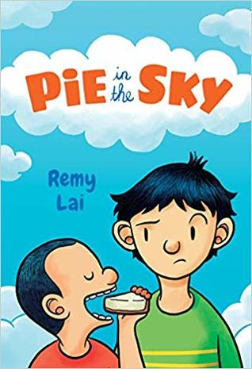
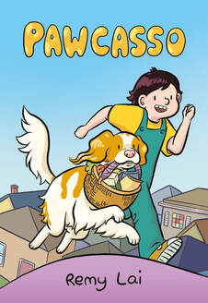
Author website: https://remylai.com/books.html
July 2021

Slide 15
A young Mongolian girl becomes an eagle huntress -- and also the subject of an award-winning international documentary
Memoir (Mongolia)
OLDER

Slide 16
Documentary (2016) - short trailer - longer trailer
Vocabulary exploration:
how female roles are titled in English, e.g., actor / actress -- or do people just use one form now - “actor”?
On planes -- now we say “flight attendant” rather than steward / stewardess
Read-a-likes / Read ons:
Stories of relationships with animals:

Slide 17
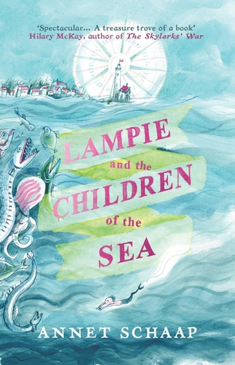
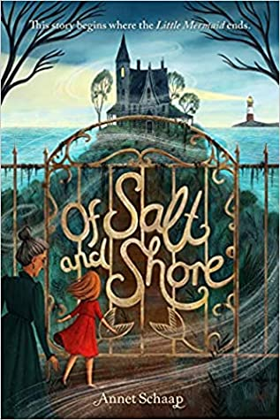
A fairytale adventure, set in a world of mermaids, pirates, and stormy seas
Fantasy fiction (Netherlands/translation)
OLDER

Slide 18
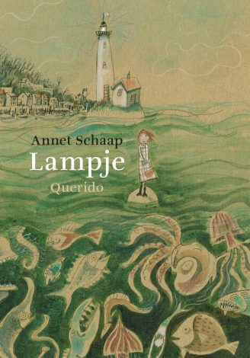
Link to the book on the author’s website -
Lesson suggestions - https://woutertjepieterseprijs.nl/lessuggesties/lampje-lessuggesties-2018/
Sea people - Mer-people
Read-a-likes / Read ons:
Mermaid/mermen - connections: ?? Gender differences between mermen and mermaids?
Boy/mermaid = connect to new Disney/Pixar film: Luca

Slide 19
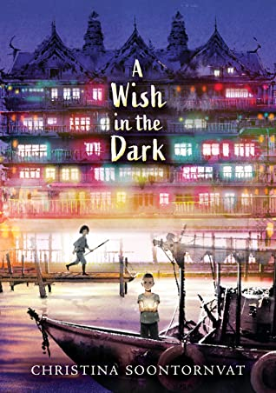
A boy on the run and a girl determined to find him -- in a world divided between rich and poor.
A Thai-inspired fantasy.
Fantasy fiction (USA/Thailand)
OLDER

Slide 20
Link to the book on author’s website where she says it’s a twist on “Les Miserables”
From her website:
Click here for Candlewick’s A Wish in the Dark Discussion Guide
Visit the TeachingBooks.net Virtual Book Tour page
Download the Reading is Resistance Lesson Plan
Listen to Christina’s interview on The Children’s Book Podcast
Her other book - nonfiction -- re the Thai boys’ cave rescue -- All Thirteen - https://soontornvat.com/books/all-thirteen/ -- with lots of related resources
Compare her book to Marc Aronson’s “Rising Water”

Slide 21
Notes from Tues, July 20th conversation @Kate B’s house: Kim K., Claude, Janine, & Katie:
Food connections -- as it opens with mangoes ripening on a tree and durians feature in Pong’s escape from the prison
Question: is life fair? (CONNECT to “Wink”)
What does each character wish for in life? Versus, what does each character need?
What is Father’s Cham’s power via his blessings?
Think about power and energy in this imaginary world - and how they are described via colors
How much magic is there in the book? What real-life power is presented (e.g., solar energy, fire)?
Both Pong & Nok have epiphanies (CONNECT to “Wink”) -- what/when are they?
What markers make this a Thai-inspired fantasy?
Personal names
The city on a river - Chattana / Wattana (Bangkok)
Style of boats
Wats - Temples/monks (color of robes)
Strings on wrist
Food

Slide 22
CONTINUED Notes from Tues, July 20th conversation @Kate B’s house: Kim K., Claude, Janine, & Katie:
Have students read abridged/graphic versions of “Les Mis” -- and see what connections they can make - Goodreads list of version here
Karma, justice, and the law in the book…. Jail vs. a reform center - are people born bad or are they capable of rehabilitation? Do tattoos symbolize the fact that those who are born in darkness always return? Light must be earned. Wickedness has a price. Light shines on the worthy. “The world is full of darkness - and that will never change.” (Fruit falling straight down - our saying - “the apple doesn’t fall far from the tree”)
The difference between restorative vs. retributive justice?
Biblical connection: the mango falling out of the tree -- the forbidden fruit in the Garden of Eden?
How does Father Cham teach Pong lessons?
This book features orphans -- what other books have students read that feature orphans?
This book features wishes -- what other books have students read that feature wishes that can true (and the danger re the need to phrase things carefully, e.g., folk tales featuring 3 wishes)

Slide 23
CONTINUED Notes from Tues, July 20th conversation @Kate B’s house: Kim K., Claude, Janine, & Katie:
What blessing does Father Cham give Pong? Does it come true?
What blessing was Anpai given by Father Cham?
What blessing was the Governor given by Father Cham?
Read about real-life novice monks in “Little Angels: Life as a Novice Monk in Thailand” (2005) - https://www.goodreads.com/book/show/1682767.Little_Angels -- Ten heart-wrenching true stories of poverty and the struggle for education - more middle/high appropriate - but you could find excerpts to read aloud/share
To what extent does the “religion” of Buddhism in the book match Buddhism in Thailand? To what extent is it a Westerner’s take on Buddhism?
Read on: what other books for young people are set in Thailand?
The Happiness of Kati -- Jane Vejjajiva
Silk Umbrellas - Carolyn Marsden

