Slide 1
Introduction to IB Mathematics
Objective: Discover the 4 different IB Mathematics courses and find out what the requirements are.

Slide 2
IB Mathematics Courses
Mathematics
Analysis & Approaches
Higher Level
(AAHL)
Mathematics
Applications & Interpretations
Higher Level (AIHL)
Mathematics
Analysis & Approaches
Standard Level
(AASL)
Mathematics
Applications & Interpretations
Standard Level (AISL)

Slide 3
The different foci of the courses
 | Analysis & Approaches (AA) Focus on pure and abstract Mathematics Emphasis on algebraic methods, generalisation and proof Real and abstract problem solving Calculus heavy | Applications & Interpretations (AI) Focus on applied and contextual Mathematics Emphasis on modelling and technology Real problem solving Statistics heavy 100% GDC.
SL | For students interested in Mathematics, engineering, physical sciences, and some economics at university. Click here for the full overview. | For students interested in social sciences, natural sciences, medicine, statistics, business, some economics, psychology and design at university. Click here for the full overview.
HL

Slide 4
The course topic breakdown

Slide 5
The assessments in the courses
SL | Analysis & Approaches (AA) Exploration (IA) - 20% Exam paper 1: non calculator - 40% Exam paper 2: calculator - 40% Both exams 1.5 hours | Applications & Interpretations (AI) Exploration (IA) - 20% Exam paper 1: calculator - 40% Exam paper 2: calculator - 40% Both exams 1.5 hours
HL | Exploration (IA) - 20% Exam paper 1: non calculator - 30% Exam paper 2: calculator - 30% Exam paper 3: problem solving / reasoning, calculator - 20% Paper 1 & 2 2 hours Paper 3 1 hour | Exploration (IA) - 20% Exam paper 1: calculator - 30% Exam paper 2: calculator - 30% Exam paper 3: problem solving / reasoning, calculator - 20% Paper 1 & 2 2 hours Paper 3 1 hour

Slide 6
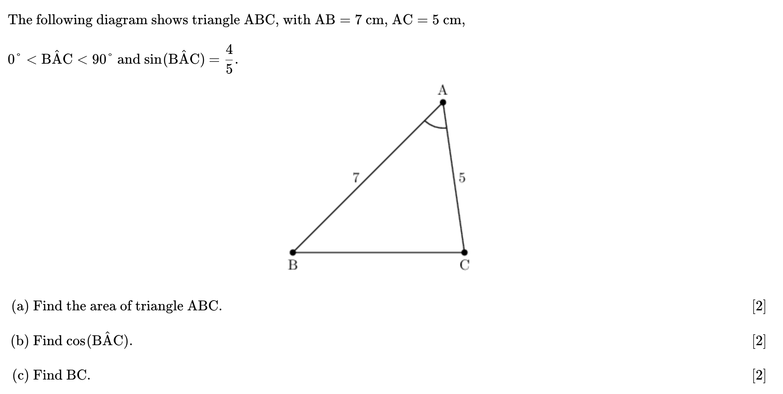
A typical AA SL exam question
Real and abstract problem solving

Slide 7
A typical AI SL exam question
Real problem solving

Slide 8
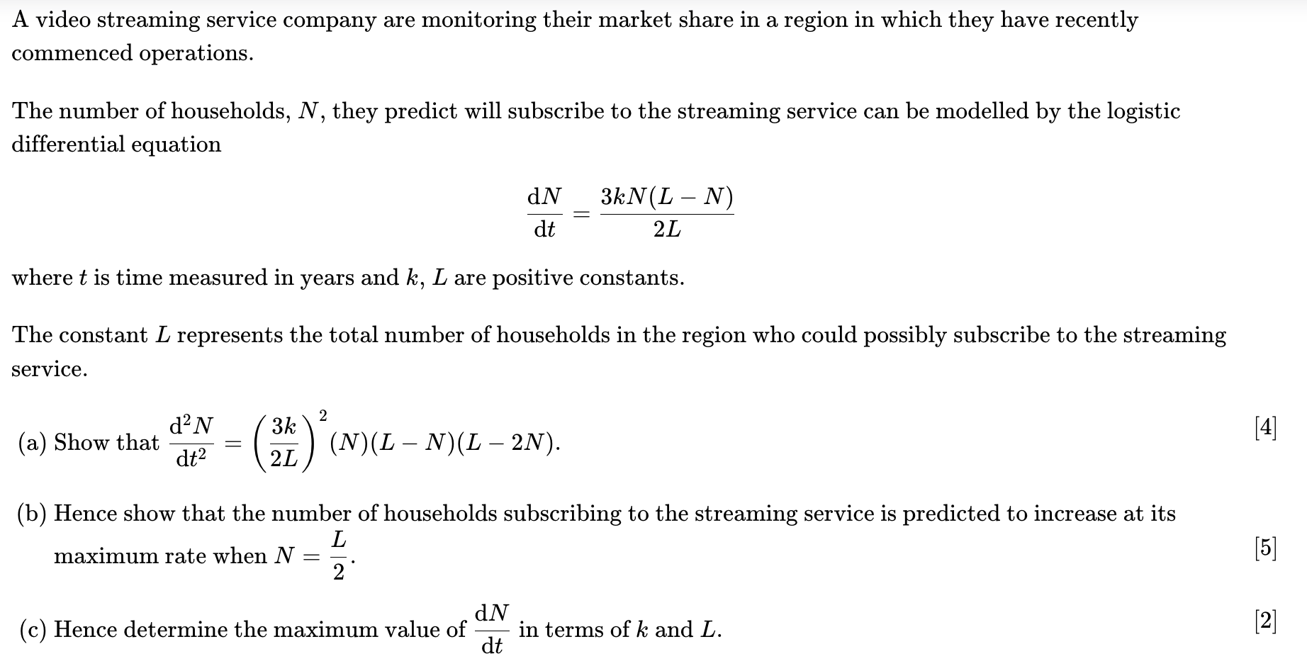
A typical AA HL exam question
Focus on pure and abstract Mathematics

Slide 9
A typical AI HL exam question
Focus on applied and contextual Mathematics

Slide 10
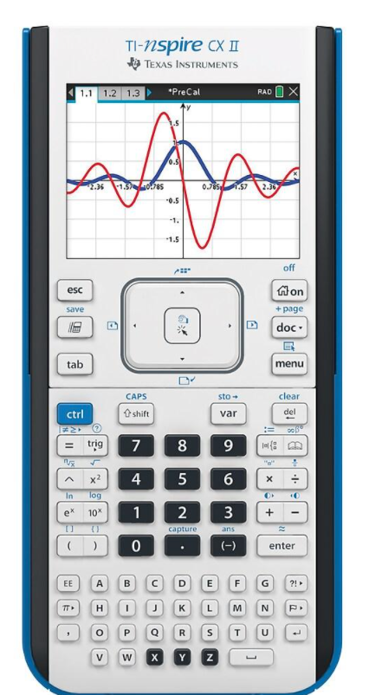
The GDC
All IB Mathematics students need a TI Nspire CX II Graphical Display Calculator (GDC).
You’ll need this for every Maths lesson!
Please buy this exact model, no other GDC models will be taught.
Buying new is recommended and keeping the box. Bring this box to your first few Maths lessons. This box comes with software that you will need for your IA.
AI need the GDC for all exams.
The course is 100% GDC focused.
AA is 50% GDC focused.
Students have one non-GDC exam paper.

Slide 11
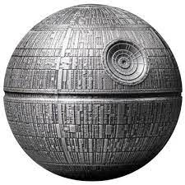
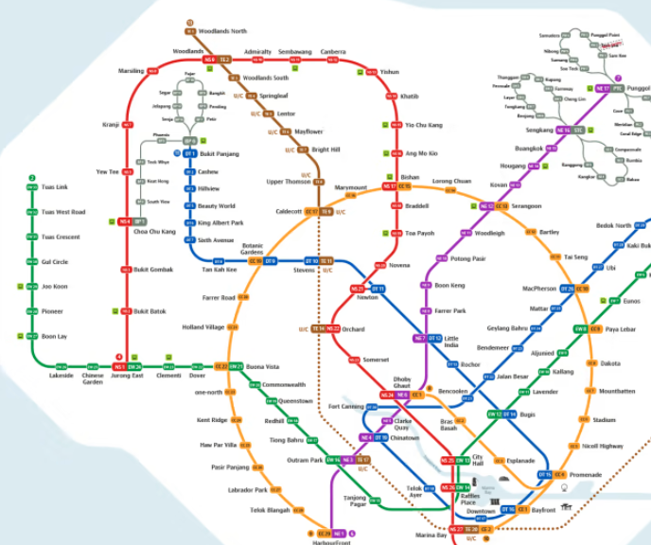
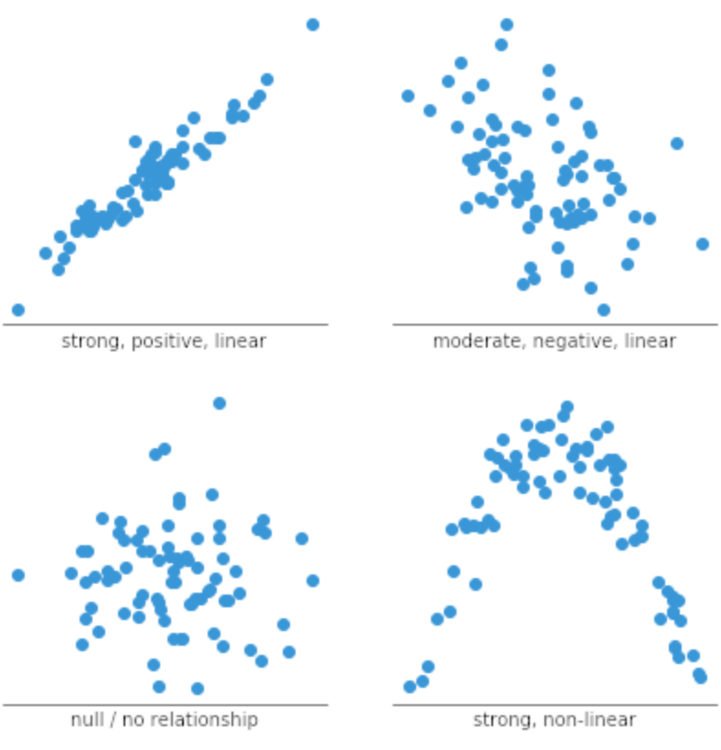
The IA
All students will write their own Internal Assessment (IA).
This is worth 20% of all students final Maths grade.
This IA is their own project that explores an idea or question using Mathematics.
Past ideas have included:
The Mathematical modelling of the Death Star using calculus.
Working out where the next Singapore MRT station should be using Voronoi diagrams.
Discovering if there is a statistical relationship between mental mathematics and student wellbeing.

Slide 12
What course is right for you?
To help you decide:
You will have one or two taster lessons (AA vs AI SL, AA vs. AI HL).
You have had this introduction session and have access to these slides and a myriad of other resources via FireFly.
You can talk it through with your Maths teacher, Ms. Staple (Head of IB Mathematics in S1-12) or a University Counsellor.

Slide 13
What we recommend for you..
SL | Analysis & Approaches (AA) If you enjoy the algebraic side of Mathematics. If you are taking Extended iGCSE Maths and are predicted an A or higher. | Applications & Interpretations (AI) If you enjoy the applied side of Mathematics and enjoy using a calculator. If you are taking Extended iGCSE Maths and are predicted a B or higher.
HL | If you truly love pure Mathematics and are committed to working hard on Maths outside of lessons. If you are taking the Additional Maths iGCSE and/or attended the Head Start to IB CCA. If you are predicted an A* in the Extended iGCSE. | If you truly love and enjoy applied Mathematics and are committed to working hard on Maths outside of school. If you are taking the Additional Maths iGCSE and/or attended the Head Start to IB CCA. If you are predicted an A* in the Extended iGCSE.

Slide 14
Is higher level for you…
Higher Level in Mathematics is a HUGE commitment!
It is a big step up from iGCSE Maths and the subjects taught go above and beyond.
We only recommend to students that TRULY LOVE Maths and are committed to working hard on it outside of lessons.
An A* in iGCSE will not transfer straight to a 7 in HL! Expect grades 3 and 4 as you adjust to the course.

Slide 15
The Maths departments commitment
The DCSG Maths team are committed to your success at IB.
We want the very best for you and will always work with you throughout all the ups and downs that IB Maths throws at you.
This is why we will recommend which course we think will suit you best based on:
Current iGCSE progress and course studied
Your overall ATL skills and a holistic picture
Your future aspirations and goals
Our long-term expertise and experience of supporting DCSG students at IB.

Slide 16
The IB Maths Mountain
It is possible for all students to succeed in IB Mathematics if they are:
Willing to try new ways of working and strategies.
Work hard outside of lessons.
Persevere when times get tough and ask for help when it becomes too much!
Keep talking to their Maths teacher about how it’s going and ask questions.
Have high but realistic expectations, using their CEM targets to support final picture for grades!
Utilise the support that is in place
Outside of lesson support from their Maths teacher or one of other 16 teachers
Maths IB Drop–in CCA
Mematical mentoring/ coaching from Ms. Staple.

Slide 17
Key IB Mathematics Resources
FireFly – click here for full student access to all our resources.
This includes:
The IB Maths Guides.
The DCSG IB Maths Course Overviews
The Haesse textbooks
The Oxford textbooks
The Hodder textbooks and exam practice books.
The formula booklets
Past exam questions
We also have school access to Kognity with all 4 courses available.
There are also head start IB Maths courses available on Dr Frost!
There will be an IB Maths Drop-In CCA running all year in S1-12.
If you really want to level up. Grab yourself a Gold Subscription to Revision Village.

Slide 18
What to do if you’re already worried?
Know that worrying about IB and Maths is a normal experience for students (and parents).
Speak to your Maths teacher about it!
Or speak to Ms. Staple (Head of IB Maths) – S1-12s door is always open!
Try a different approach with your teachers support.
Work hard, persevere and ask questions during your iGCSE Maths preparation.
Start working on topics you already find hard in Maths using the myriad resources on the previous slide.
Utilise the support you have in school!
Ms. Staple is always here for any worries, questions and general Mathematical advise!

