Slide 1
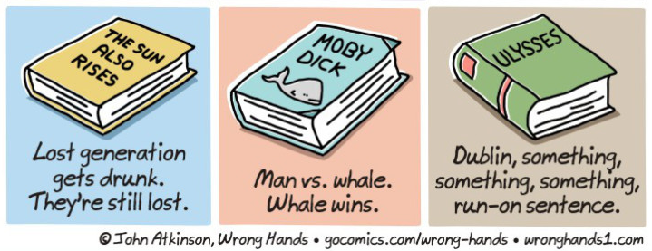
Book Week Competition
Could you abridge a classic novel (as above) in up to 10 words?
Please use the space below for your entry. Either email your entry to Library@dulwich-singapore.edu.sg or leave in the Competition Box at any of the Reception desks by 6th March, please.
Name: Contact Email:

