Slide 1
READERS FESTIVAL
2022
CELEBRATING

Slide 2
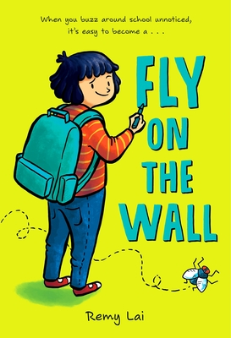
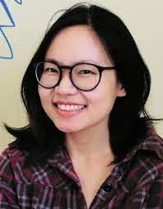
Remy Lai:
Author Talk for Older Readers
Remy Lai writes and draws stories for kids.
She lives in Brisbane, Australia, where she can often be found exploring the woods near her home with her two dogs, Poop-Roller and Bossy Boots.
(https://remylai.com/about--contact.html)
Link to Google Doc with links for librarians to access

