Slide 1
Reading for Research

Slide 2
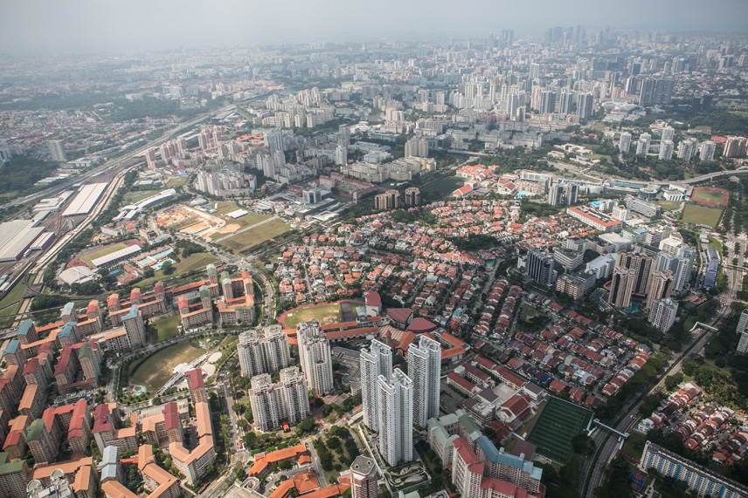
Scanning: Aerial View

Slide 3
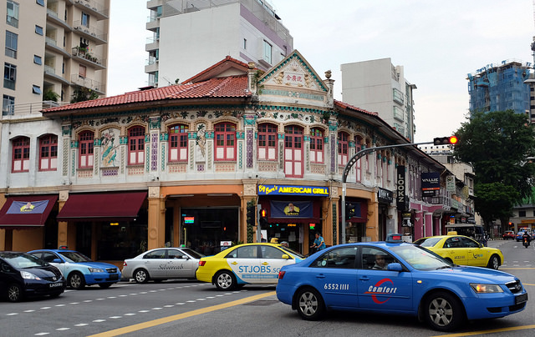
Skimming: Driving Around

Slide 4
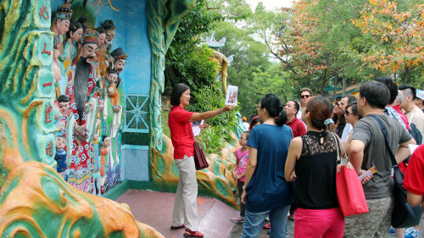
Deep Reading: Walking Tour

Slide 5
EE Research Skills:
EBSCO and JSTOR databases
Thanks to Kim Beeman, teacher librarian @ Tanglin Trust School for allowing us to adapt this presentation for use at Dulwich College, Singapore

