Slide 1
Pixelated Book Cover Quiz
These popular book covers have been pixelated, can you guess what books they are?

Slide 2
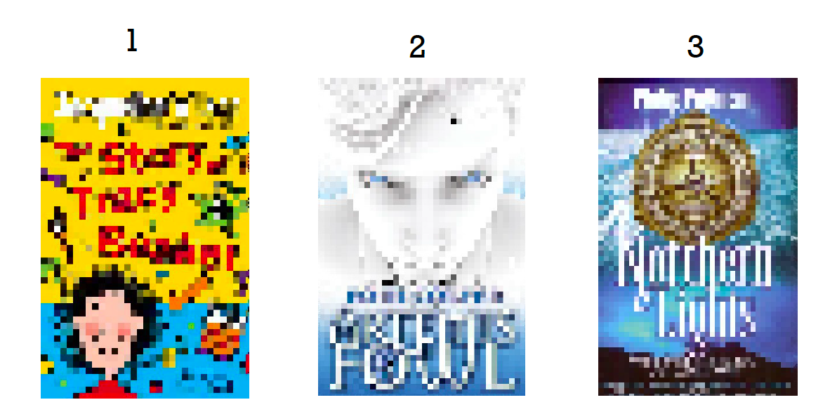

Slide 3
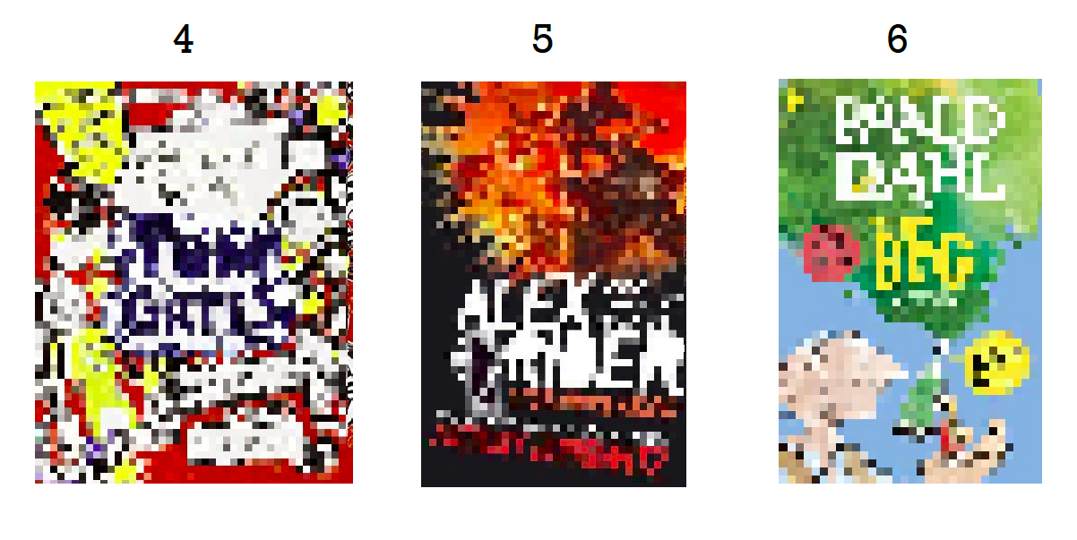

Slide 4
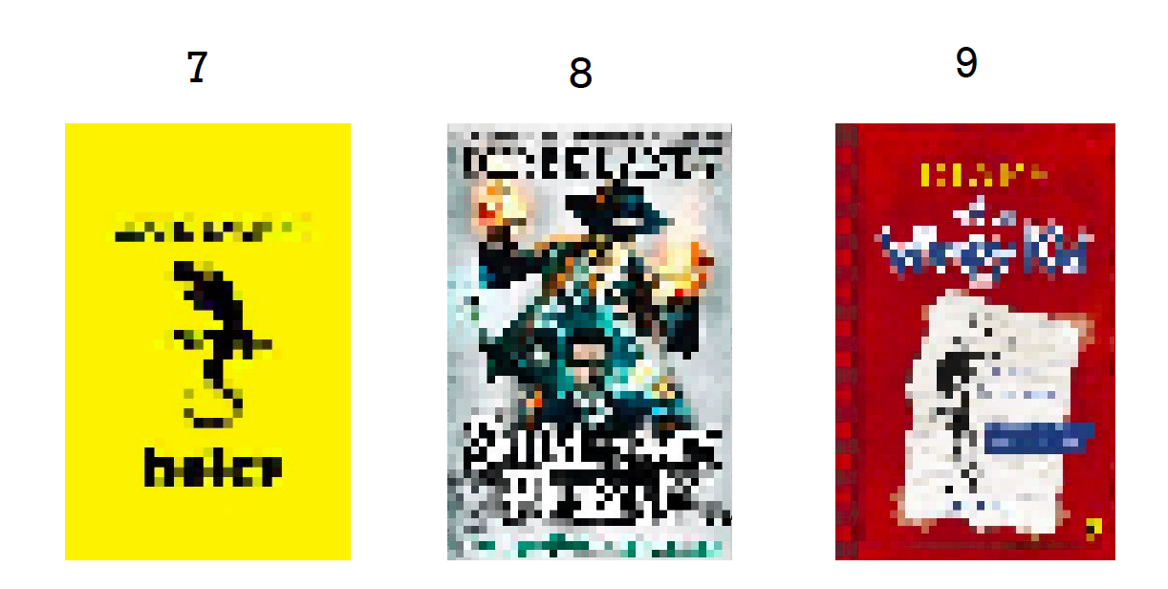

Slide 5
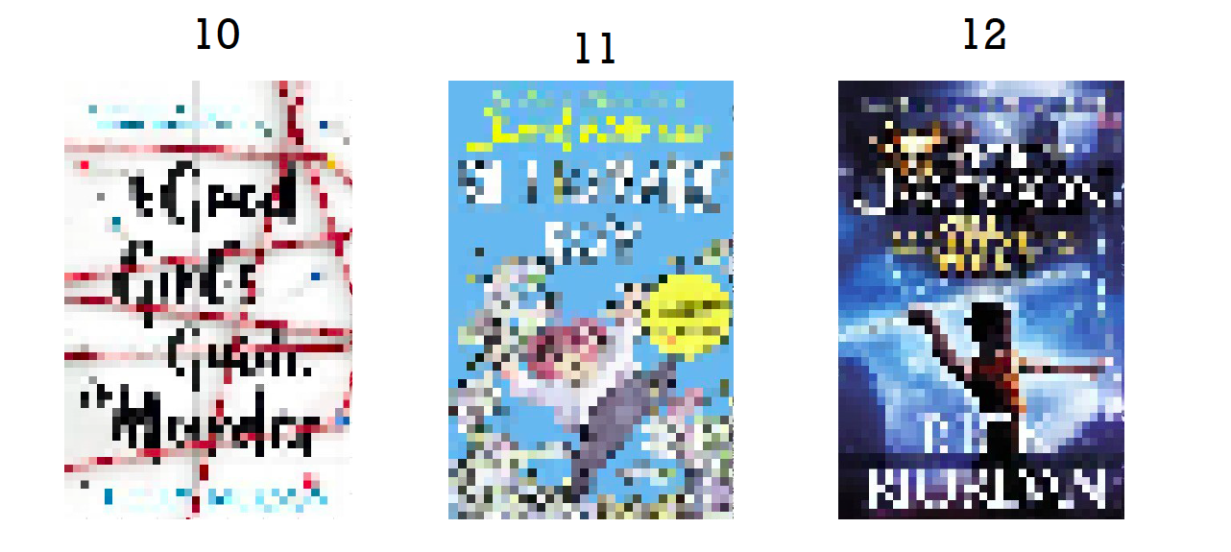

Slide 6
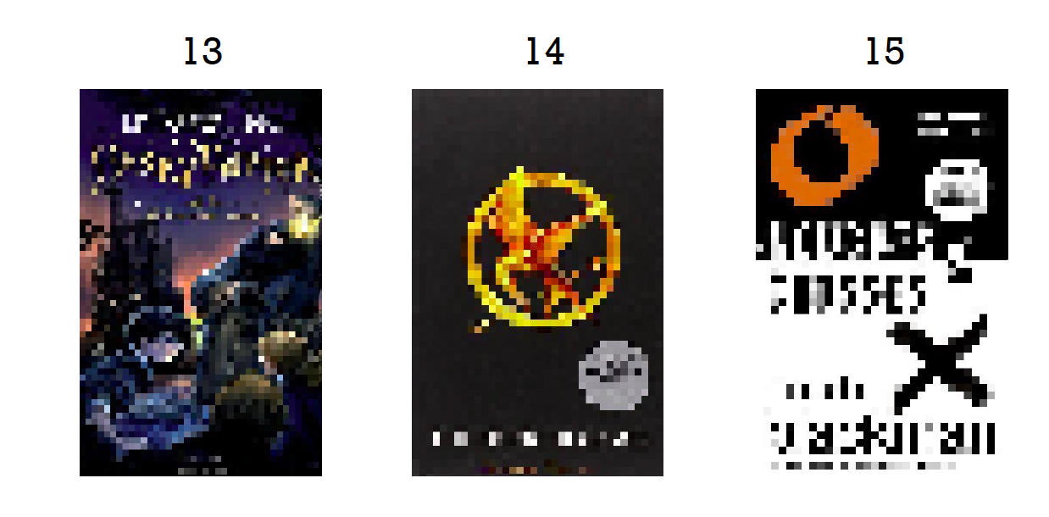

Slide 7
Answers on the next page

Slide 8
The Story of Tracey Beaker by Jacqueline Wilson
Artemis Fowl by Eoin Colfer
Northern Lights by Phillip Pullman
The Brilliant World of Tom Gates by Liz Pichon
Alex Rider Stormbreaker by Anthony Horowitz
The BFG by Roald Dahl
Holes by Louis Sachar
Skullduggery Pleasant by Derek Landy
The Diary of a Wimpy Kid by Jeff Kinney
A Good Girls Guide to Murder by Holly Jackson
Billionaire Boy by David Walliams
Percy Jackson and the Lightening Thief by Rick Riordan
Harry Potter and the Philosopher’s Stone by J.K. Rowling
Mockingjay by Suzanne Collins
Naughts and Crosses by Malorie Blackman

