Slide 1
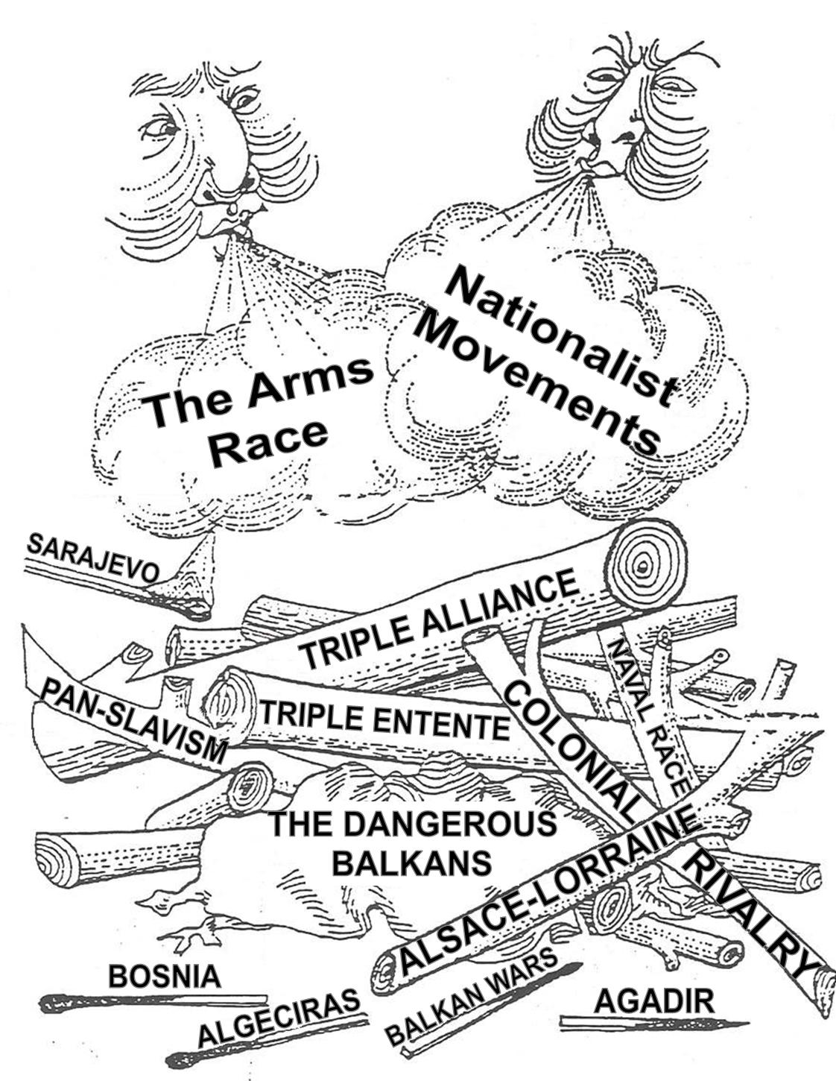
Title – Exam Technique and Revision
Starter questions
When was the first Moroccan crisis?
When was the Agadir crisis?
Which crisis involved the gunboat Panther?
How many Dreadnoughts did Germany built by 1914?
Who won the Battle of Jutland?
Challenge - Why were the Moroccan Crises important? Which one, in your opinion, was a greater cause of tensions? Why?

Slide 2
How can you be successful in a WWI paper?
Combine own knowledge and sources in the 16-marker!
Just ANSWER the question!
Use specific, short quotes in the 8-marker!
Use precise evidence in the 6-marker!
Make sure you actually mention your overall opinion in the topic sentences of the essay!
Include a conclusion on the 8-marker. How far do the sources support each other?

Slide 3
Q1a – Describe two features...
6 marks
9 minutes
Start with a broad feature, then narrow in
Fully develop each feature, using specific information to support your points
Use 'because' in each paragraph
Leave a line between each feature
Need precision – you have to revise!

Slide 4
For example:
A) Describe TWO features of the new weapons used in the First World War [6 marks]
One feature of new weapons was the use of tanks. They could traverse rough terrain, go over barbed wire and created fear among enemy soldiers. However, they were extremely hot and not reliable when first used. In the Battle of the Somme in September 1916, 50 tanks were used, but 29 of these broke down before reaching the battlefield, and others got stuck in the mud. The tanks were first successfully used at the Battle of Cambrai in 1917.
A second feature of the new weapons was the machine guns. These were very effective defensive weapons as they could cause a huge number of casualties with minimal people needed to operate them. 90% of the casualties in the Battle of the Somme came from German Maxim guns. The British Vickers machine gun could fire up to 500 bullets a minute. The effective use of machine guns therefore greatly contributed to stalemate on the western front.

Slide 5
The examiner is looking for...

Slide 6
Q1b – How far does the evidence of Source B support the evidence of Source A about...?
8 marks
12 minutes
Agree paragraph (with quotes from each source and explanation)
Disagree paragraph (with quotes from each source and explanation)
Overall judgement on how far the sources support each other – don't sit on the fence! Try to use 'although'...
Use the wording of the question
Make the point, then support it with concise quotes, naming which source they come from (e.g. Source A supports Source B about …. This is evident when Source A mentions ‘….’ which is similarly mentioned as ‘…’ in Source B’.
Focus on COMPARISON, not individual description – comparative vocabulary
No need for any own knowledge or discussion of origin of source

Slide 7
The examiner is looking for...

Slide 8
Q1c – Essay question. Interpretation (from C) - how far do you agree? Use sources and extract?
16 marks
25 minutes
Brief introduction, summing up opinion
2 or 3 paragraphs (agree with C’s interpretation, then disagree with C’s interpretation)
Conclusion – CRUCIAL!
MUST use evidence from both sources, the extract and your own knowledge – integrated together
Name sources/extract when you use them – quotes needed
FOCUS ON THE QUESTION! REFER TO EXTRACT C’S INTERPRETATION IN TOPIC SENTENCES
Knowledge needs to be specific – dates/names/places/people/events
Try to build a judgement throughout, don't just stick it on the end

Slide 9
The examiner is looking for...

Slide 10
Things you could do that would be sensible:
Look at the specification and focus on your weakest topics
Revise exam technique and make sure you know how to answer each type of question
Plan predictable questions/themes (or use the summary questions at the end of each section in the textbook)
Look back at previous exam questions and read my feedback so that you don’t make the same mistake twice
Take active and condensed notes from the textbook or online revision guide
Black-pen-green-pen mindmaps
Timelines (although don’t obsess over this, it’s often not actually that useful)
Use online flashcards e.g. Quizlet, Seneca

Slide 11
How to revise for History:
ACTIVE not PASSIVE – you need to be doing something
Revise sensibly – not everything
Condense information – don't try to learn it all!
Revise exam technique! Make sure timing is not a problem!
Flashcards (online or handwritten)
Timelines (or post-it notes! Or flashcards with dates!)
Plan or write predictable questions – particularly essay questions! Predict criteria and your opinion on common topics.
Learn 2/3 facts about each topic (e.g. features) - revise wisely
Mind-maps (black-pen-green-pen)
Colour
Test yourself – or get a family member to help you
PLAN ahead – don't try to do everything the day before, make a schedule
Don't worry about the whole picture, just focus on little by little
Anything is better than nothing (even short videos, 10 minutes) - https://www.youtube.com/channel/UCFJY1yAJP4-2yF-K7wwDHqw/videos?disable_polymer=1
Use the textbooks (on Firefly) and other revision resources online (Firefly!)
Use Seneca or Quizlet
USE THE SPECIFICATION

Slide 12
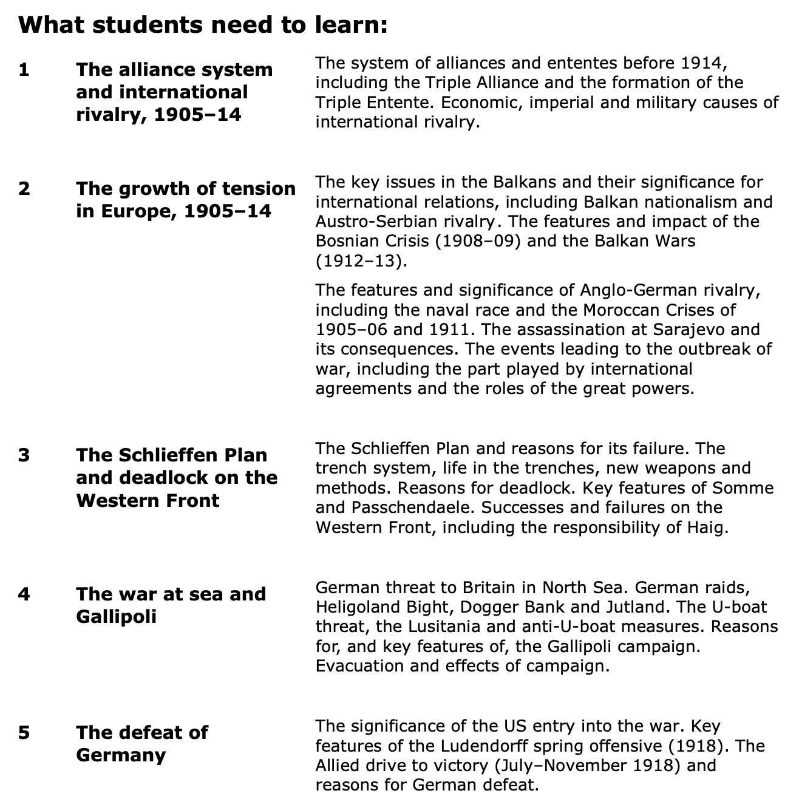
Independent tasks:
Focus on exam technique and specific information.

