Slide 1
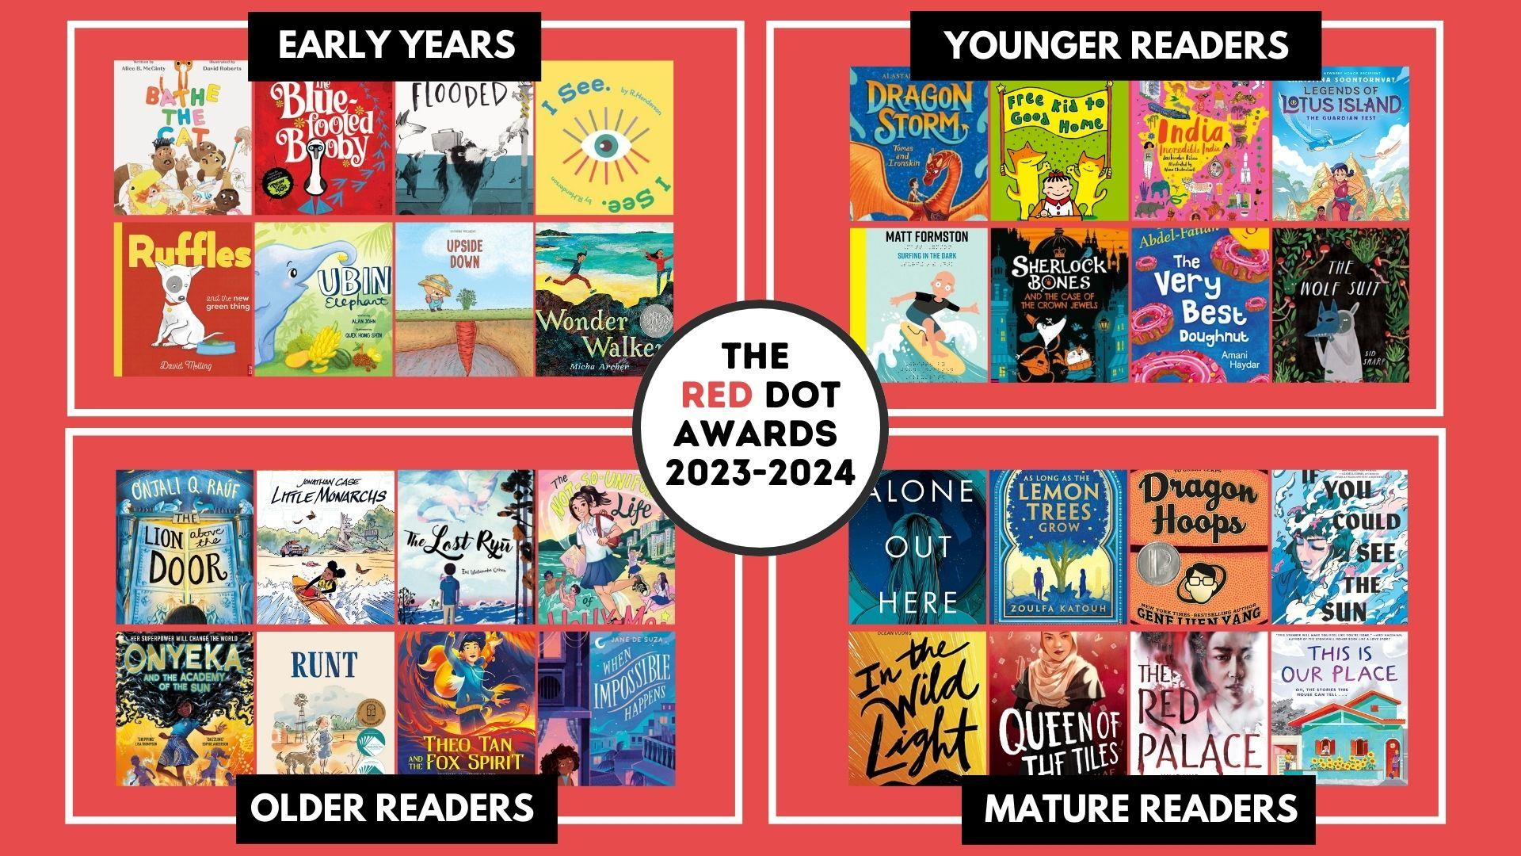
Current Red Dots: reddotawards.com
Notes:
Here is the link to the spreadsheet. All of the books that were nominated are also there. It is a great place to look for books to order.
You can get the bibliography and purchasing info from all of the slides and the website will also be updated with this information. This slideshow is the 32 books of next years red dot

Slide 2
Early Years
Younger Readers
Older Readers
Mature Readers
Shortlists
(8 books/category)
Started in 2009
International Schools
Red Dot Winners:
Voting in each school + overall Singapore winner
Voting open from 1 Feb to 1 May
Voting form: http://bit.ly/redvote2024
Winning books announced 11 May

Slide 3
Readers Festival Competition:
A celebration of the Red Dot titles!
Using the Red Dot books to enhance our reading communities:
Online Kahoot quiz
April 22 -26
Live Celebration Event
Sat. May, 11th

Slide 4
ISLN Readers Festival 2024 - THE QUIZ
Features our fabulous Red Dot titles
All online Kahoots
Designed to be completed in 60 -70 mins
Flexible: you choose the timing
Great turn-key book club idea
Get your reading community excited to read!
Shared resources and practice quizzes make prep easy
Medals and trophy for quiz winners
ISLN & Closetful of Books donations to each winning quiz team to support a local literacy charity of their choice
Deadline for registering a team: March 22
Notes:
Pinboard no school names padlet

Slide 5
BOOKS IN QUIZ
Notes:
Pinboard no school names padlet

Slide 6
ISLN Readers Festival 2024 - THE QUIZ
IT’S NOT TOO LATE!
Different strokes for different folks:
Recess or lunch drop in to listen to read aloud
Teams have ‘experts’ on one or two books rather than all of them
@CIS - Older RF lunchtime book clubs
@CIS - Mature lunchtime team meetings, monthly group
@Tanglin - whole school initiative
@SAS - after school ECA

Slide 7
ISLN Readers Festival 2024
NEW THIS YEAR:
Student teams contribute practice quizzes as part of a reading community!
Shared inter-school activities
See detailed information here: http://bit.ly/readersfestival2024
Notes:
TENTATIVE

Slide 8
ISLN Readers Festival 2024 - LIVE EVENT
WHAT’S HAPPENING:
Saturday, May 11th, 10:30 to 1:30
Inter-school activities for each category
Live awards ceremony (RF Quiz winners, Red Dot winners, next year’s Red Dot titles
Live author talk at ceremony
Pizza and cookie lunch
All students accompanied by their sponsor/teachers according to their school protocols
See http://bit.ly/readersfestival2024

Slide 9
ISLN Readers Festival 2024 - LIVE EVENT
PROPOSED TIMING:
Team check-in: 10:00 - 10:30
Inter-school activities: 10:30 to 11:25
Lunch: 11:30 - noon
Live presentation:
Live author talk to all students 12:05 - 12:45
Quiz Winners presentation 12:45 - 1:30
Slide deck
Closing remarks

Slide 10
ISLN Readers Festival 2024 - LIVE EVENT
YOUNGER ACTIVITIES:
20-minute rotations
Jingle
RED DOT Bingo
1-min Readers Theatre (we will share a demo)

Slide 11
ISLN Readers Festival 2024 - LIVE EVENT
OLDER ACTIVITIES:
20-minute rotations
Breakout room
60-sec ‘live’ performance of favourite scene
Personality genre quiz (which of the books is closest to your genre personality)

Slide 12
ISLN Readers Festival 2024 - LIVE EVENT
MATURE ACTIVITIES:
Live virtual author talk: Ann Liang
Read alike discussion
Create list for others
Create playlist
Notes:
TENTATIVE

Slide 13
ISLN Readers Festival 2024 - LIVE EVENT
EVENT DETAILS:
Open to all team members participating in RF Quiz
All participating students will have access to recorded author talk
All participating schools will have access to RF Celebration slide deck
Flexibility based on participation numbers

Slide 14
ISLN Readers Festival 2024
Key Dates:
November 30: announce details of the Readers Festival including dates and cost
January 15: Team registration opens
January 29: Titles for quiz announced & teams can start submitting practice questions for sharing
March 29: Deadline for Readers Festival payment and registration of the number of teams per school per division
April 2: Deadline to submit names of all participants on each team
Mon-Fri, April 22-26: Readers Festival Quiz (5 days) may be completed anytime during this period
May 11 (Saturday): Optional Live Readers Festival Event – Readers Festival Quiz winners announced, Red Dot winners announced, Next Year’s Red Dot shortlist announced, live virtual author talk (format to be finalized)with recording available for a week after to all participating schools, medals and trophy presented (will be delivered to schools not able to attend)
May 13: Slide deck released including: Readers Festival Quiz winners announced, Red Dot winners announced, Next Year’s Red Dot shortlist announced

